Slide 1
SPATIALIZING CONGESTION
Preliminary results

Slide 2
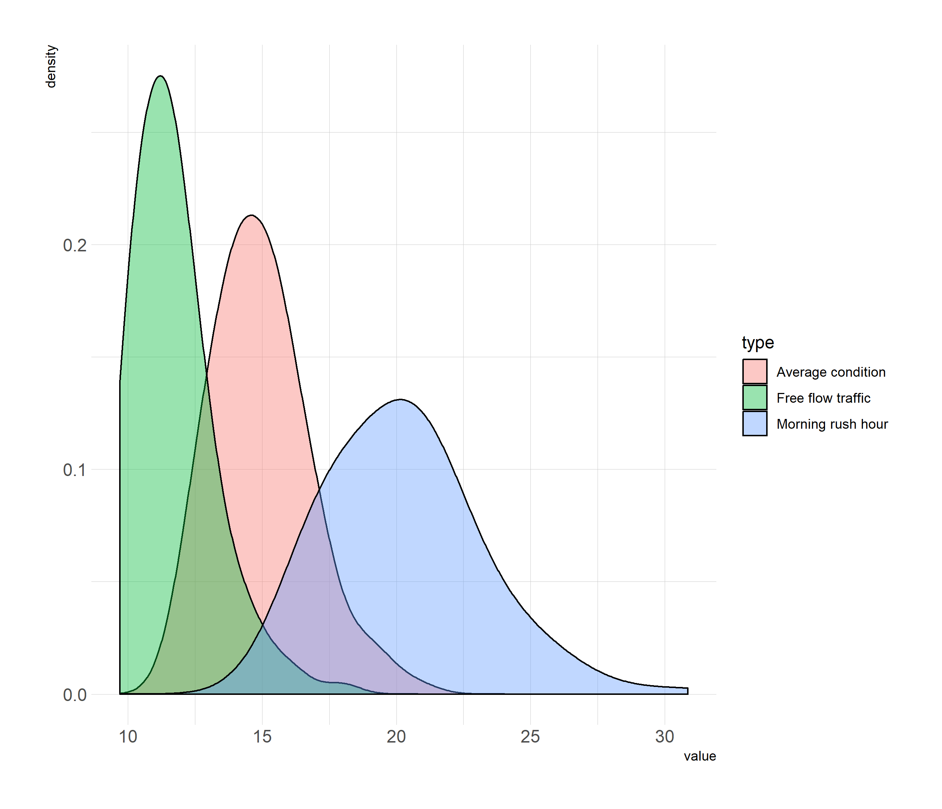
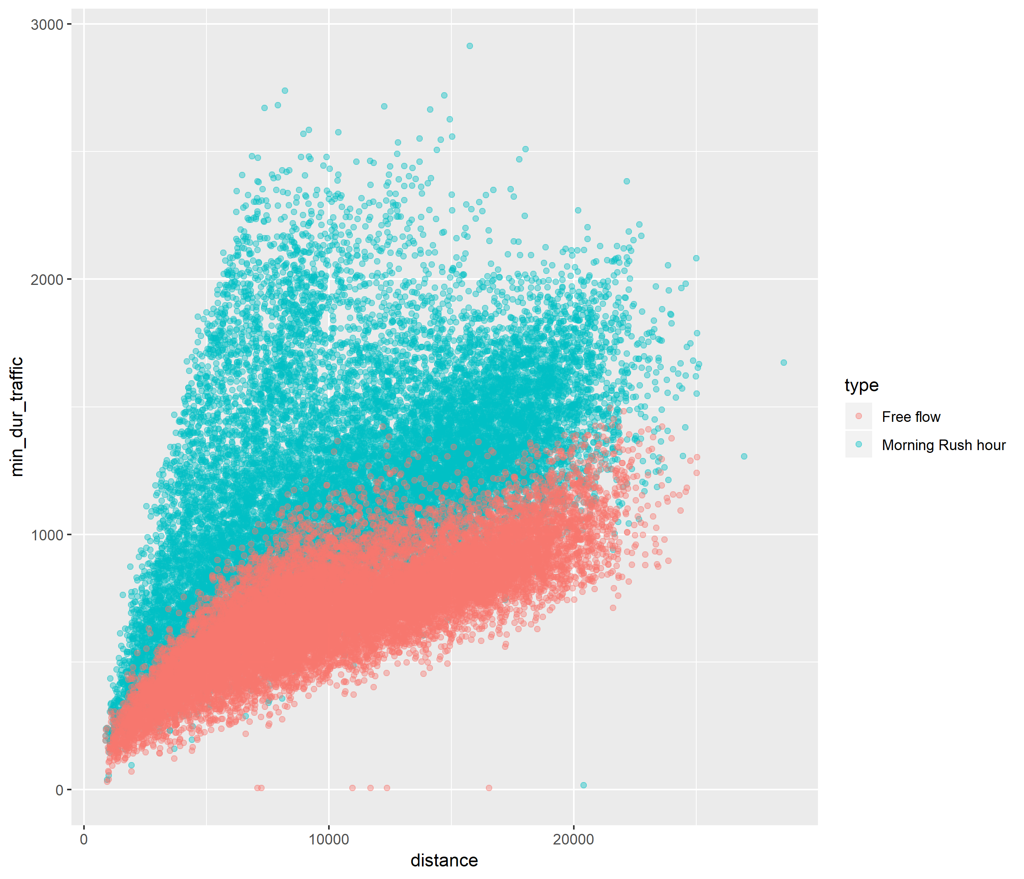
Amsterdam

Slide 3
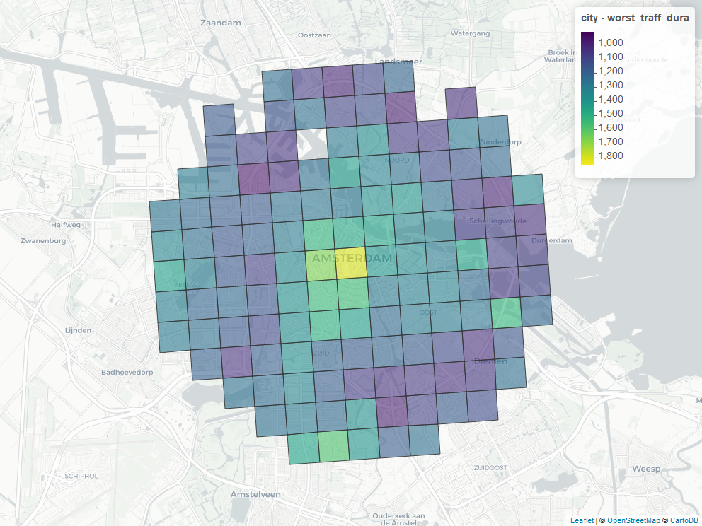
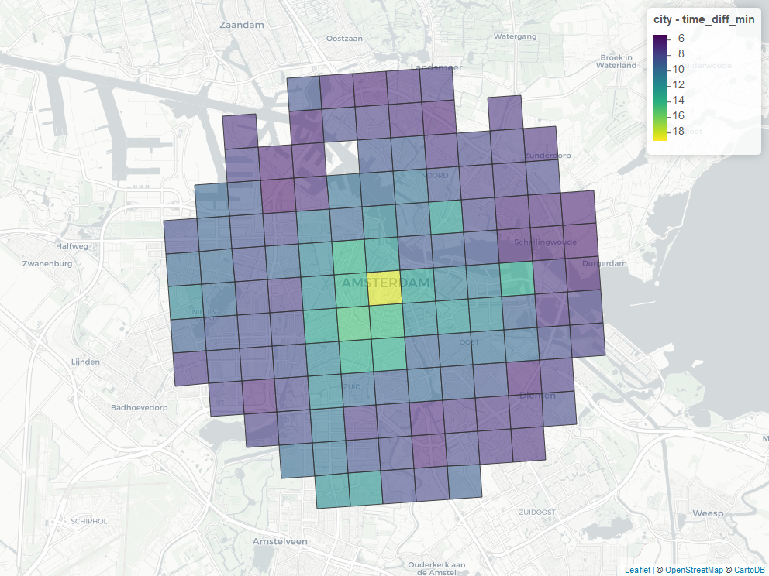
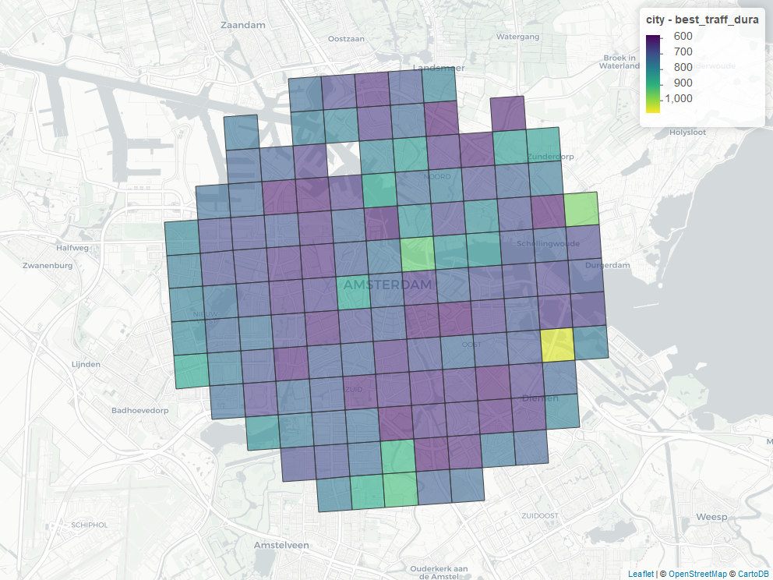
Amsterdam

Slide 4
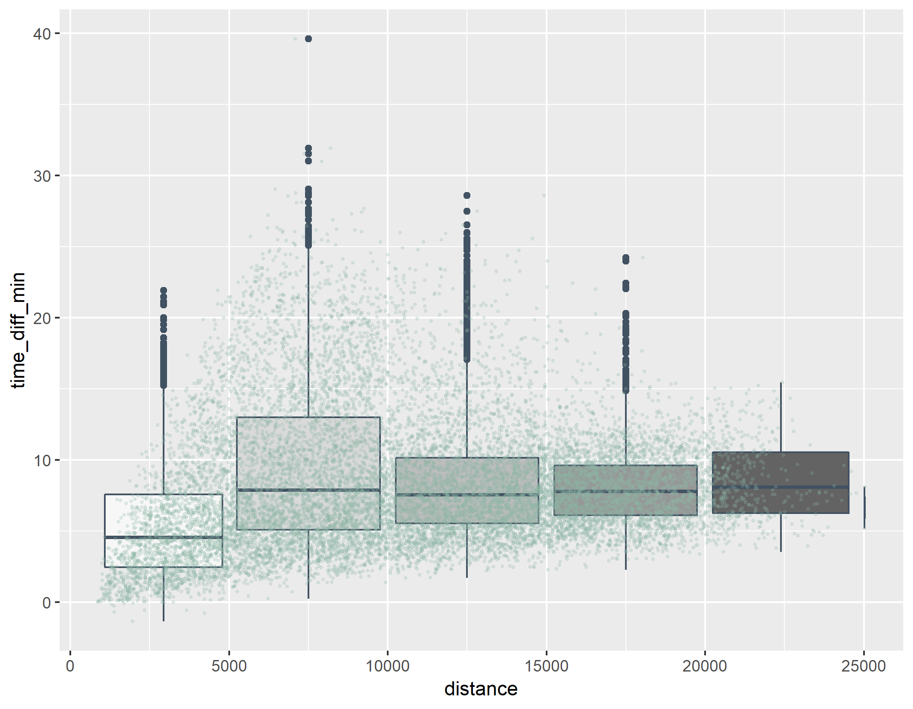
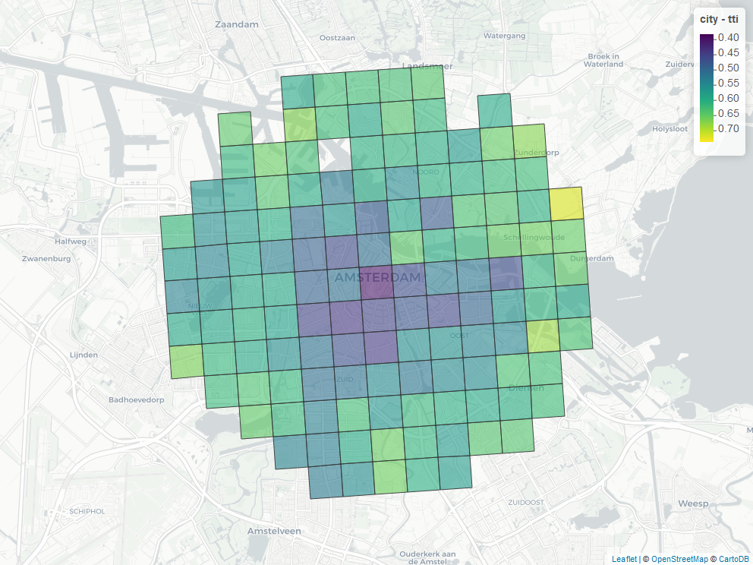
amsterdam

Slide 5
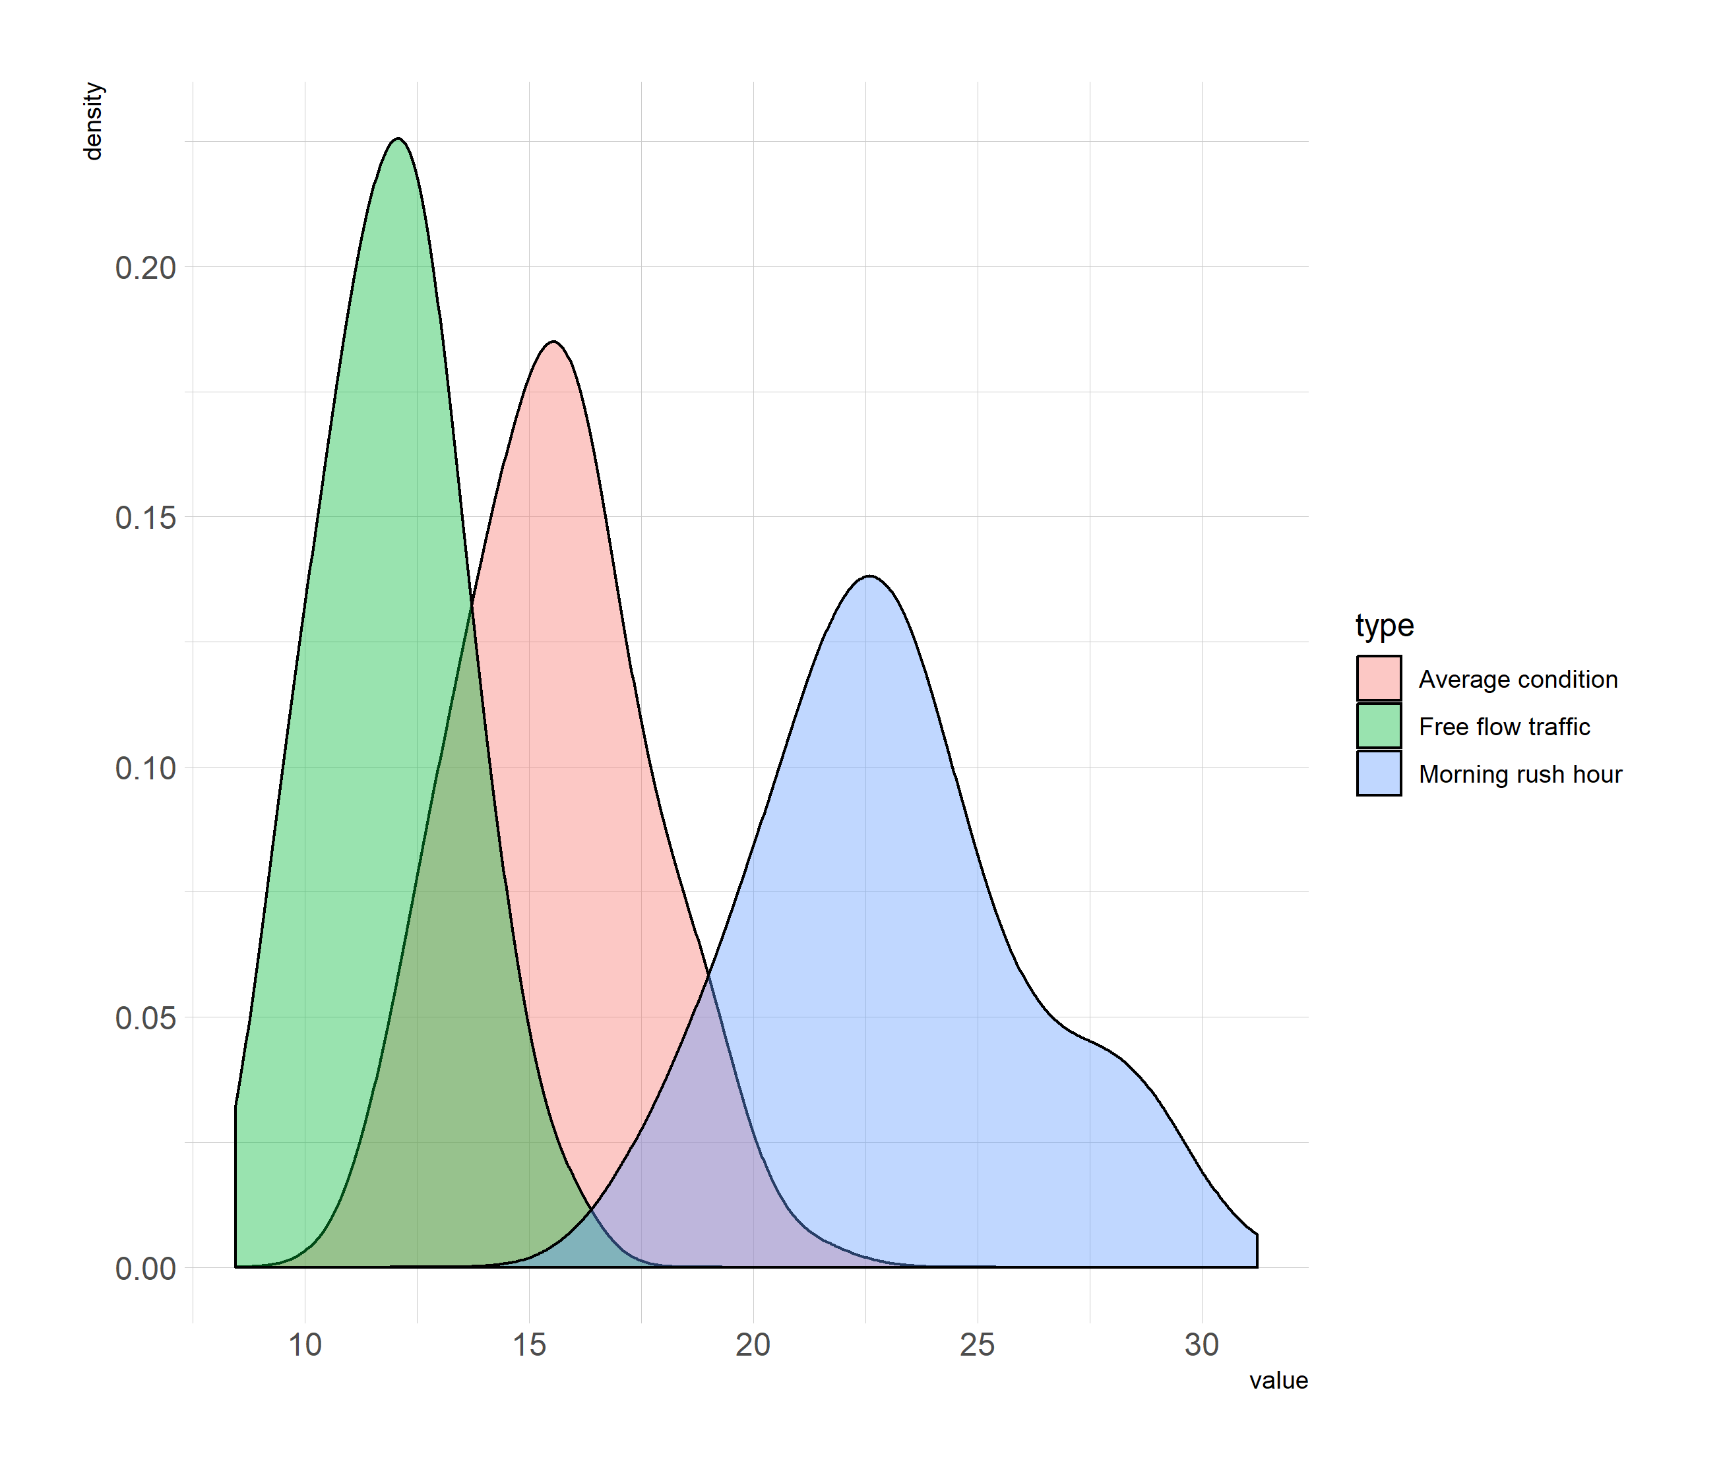
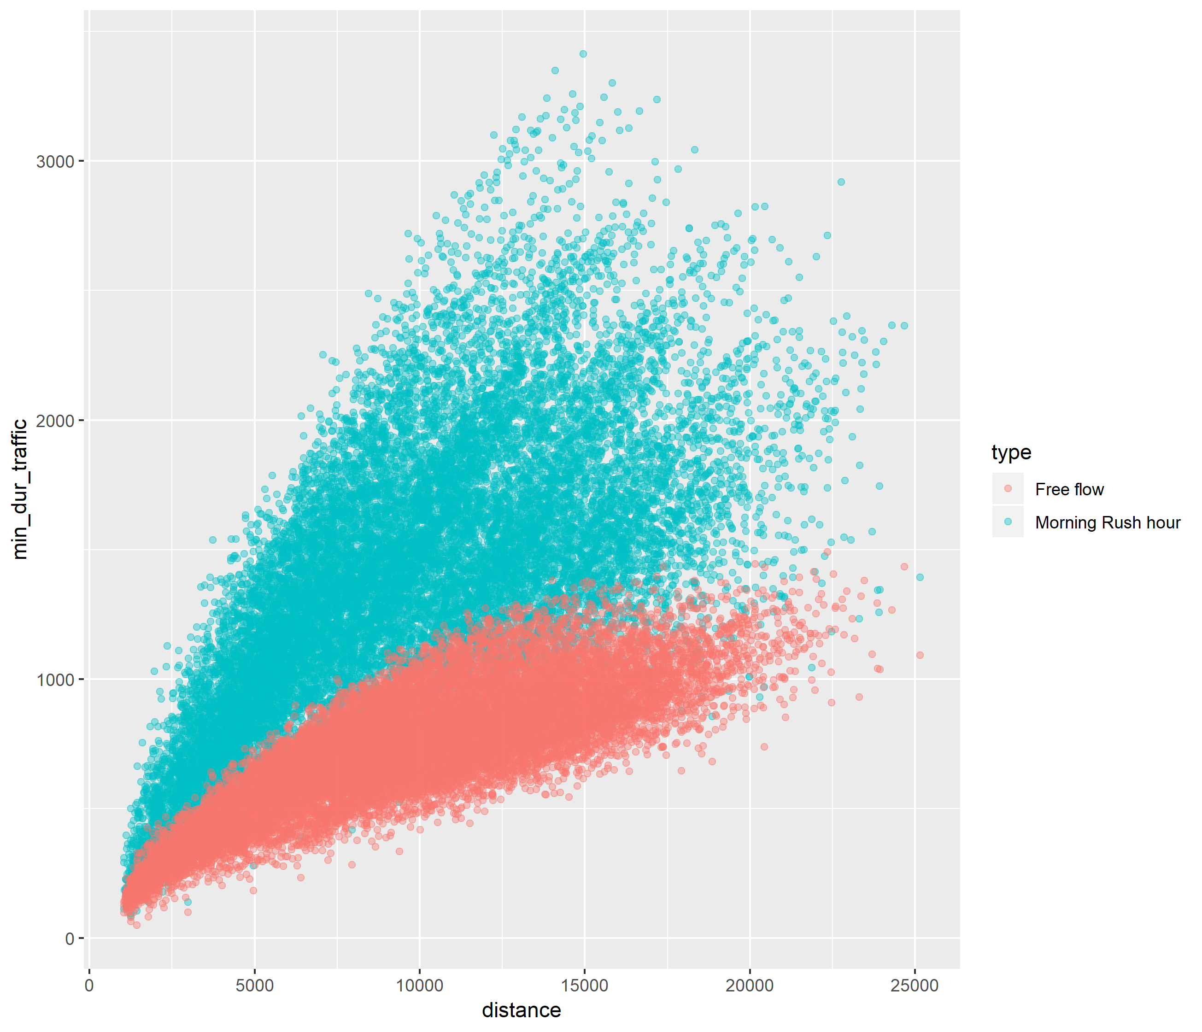
Glasgow

Slide 6
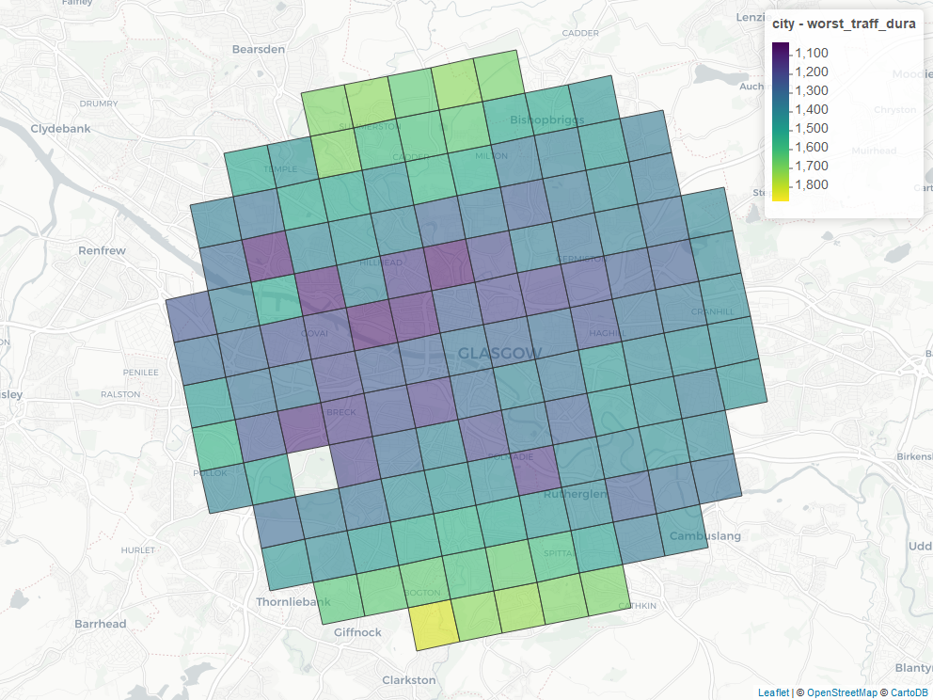
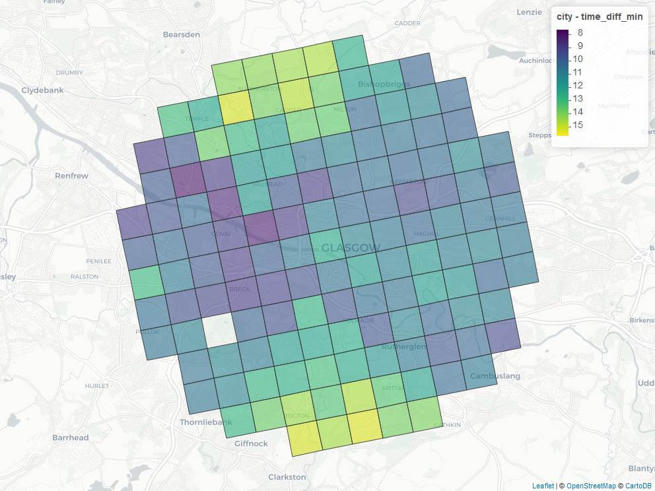
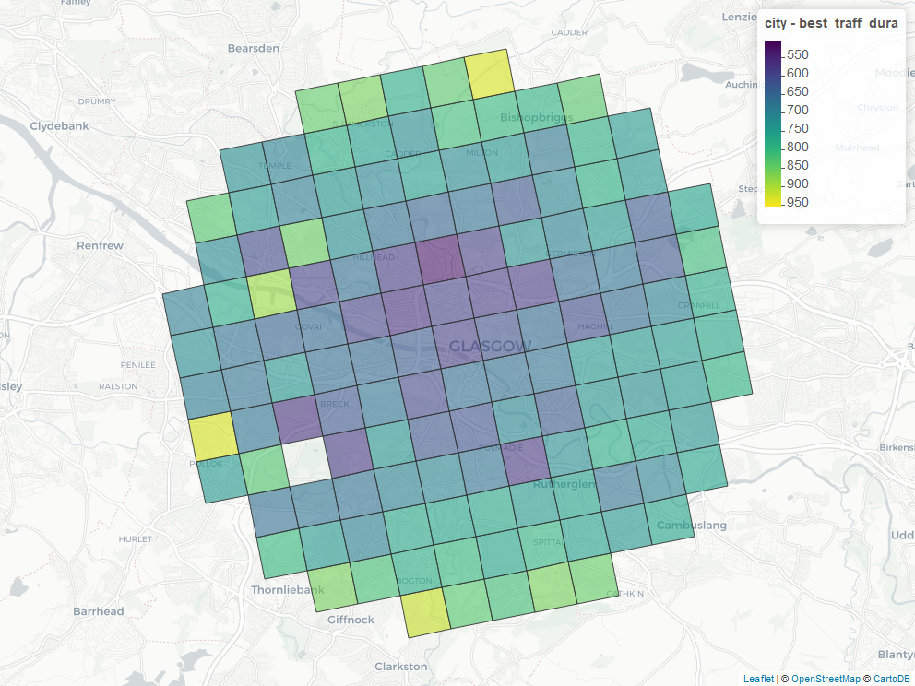
Glasgow

Slide 7
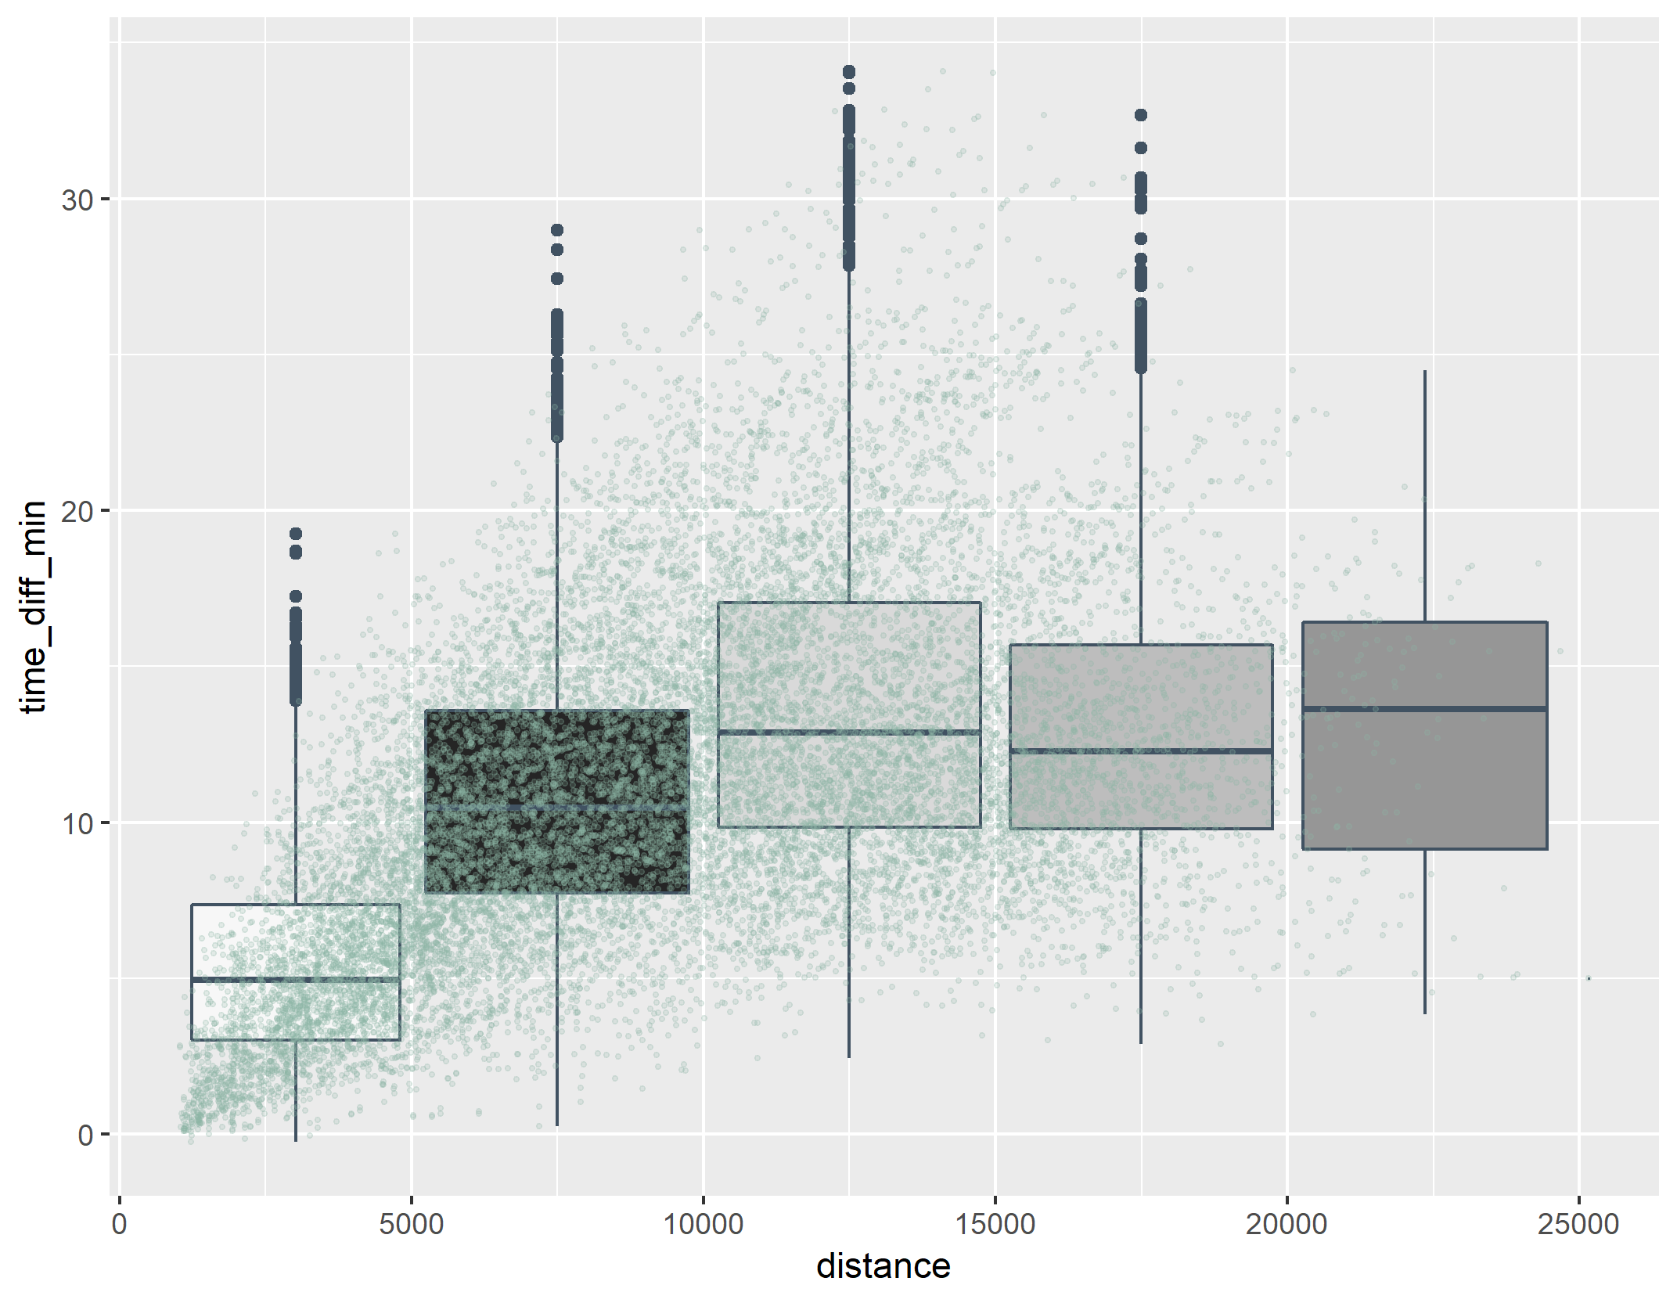
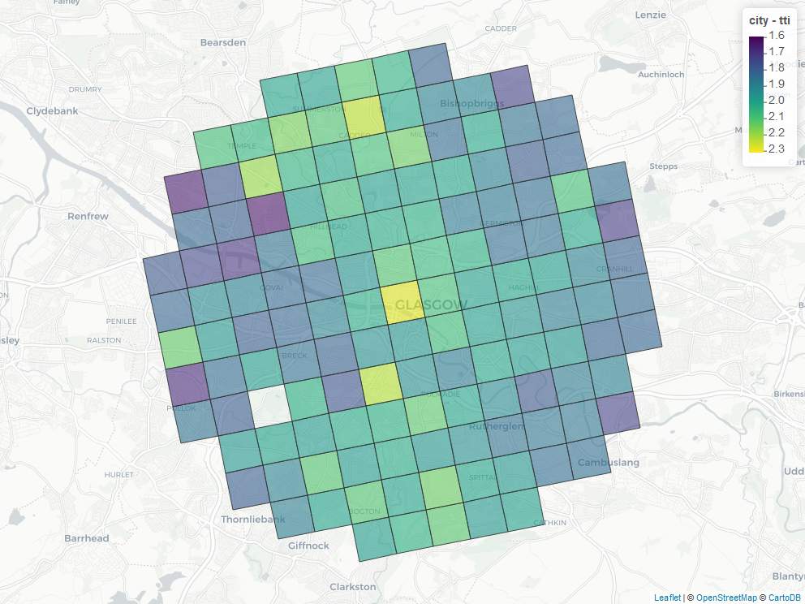
glasgow

Slide 8
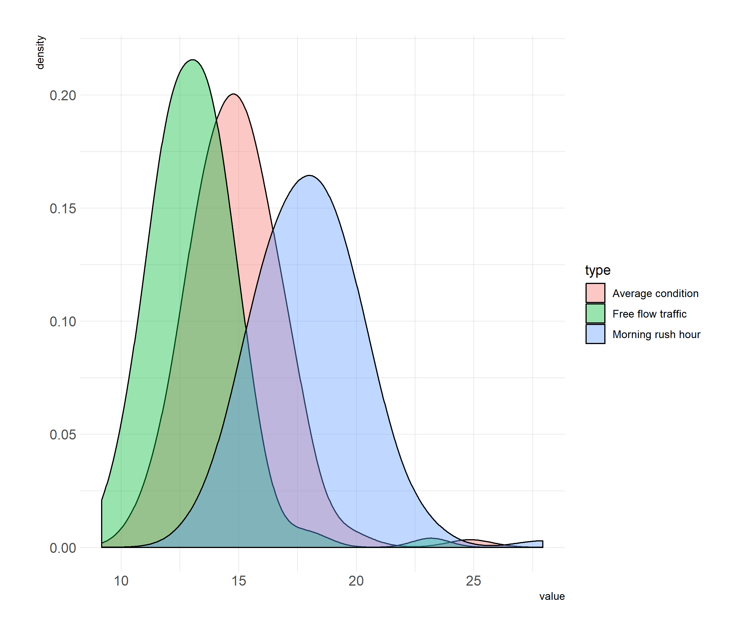
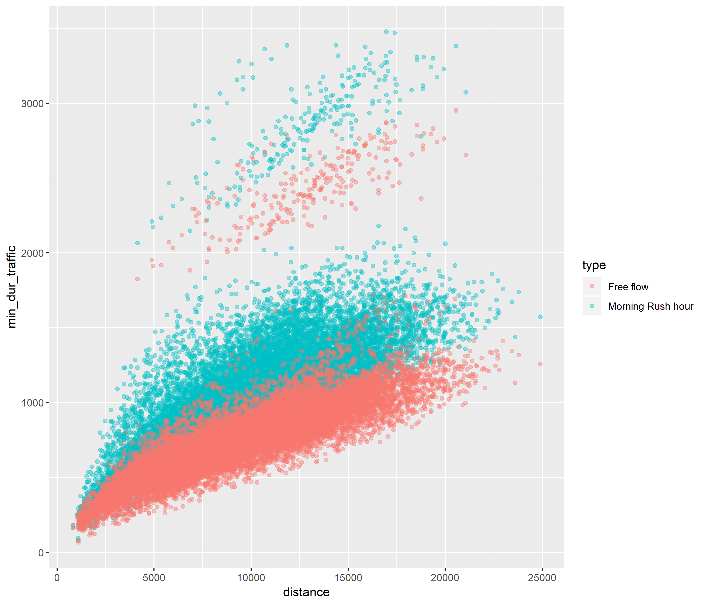
Goteborg

Slide 9
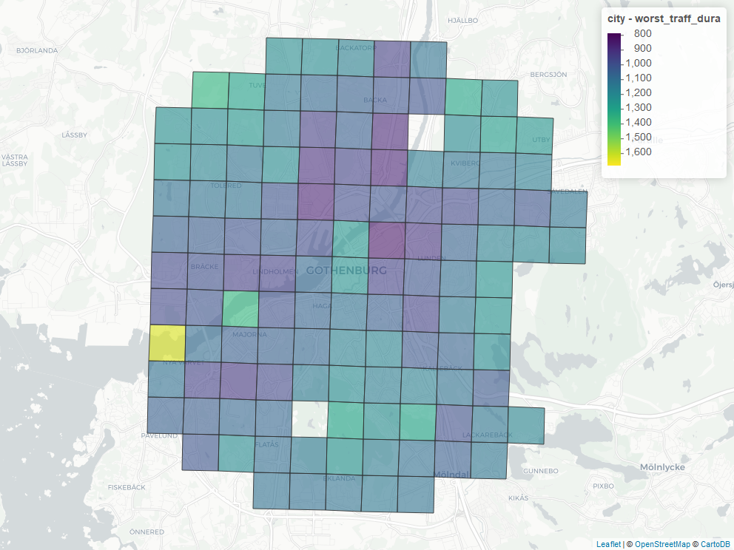
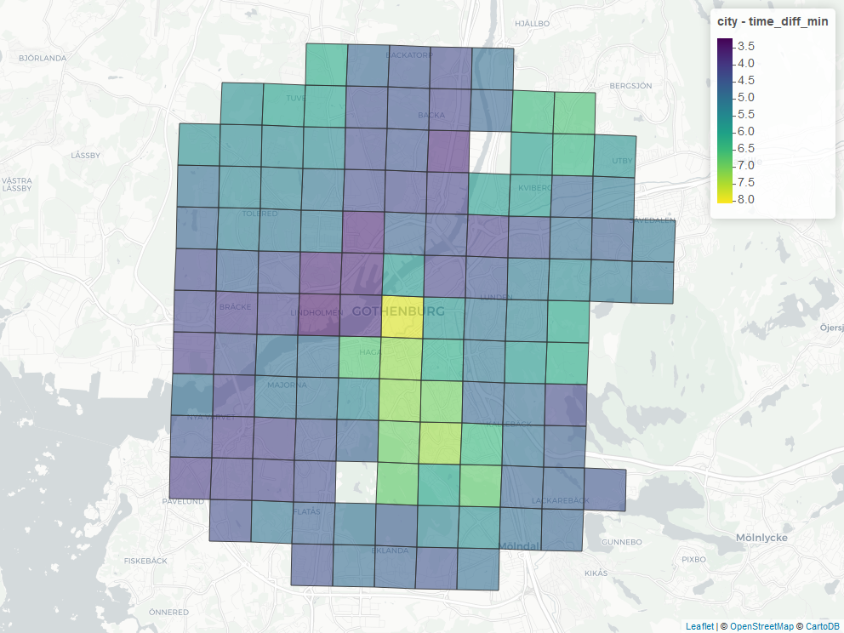
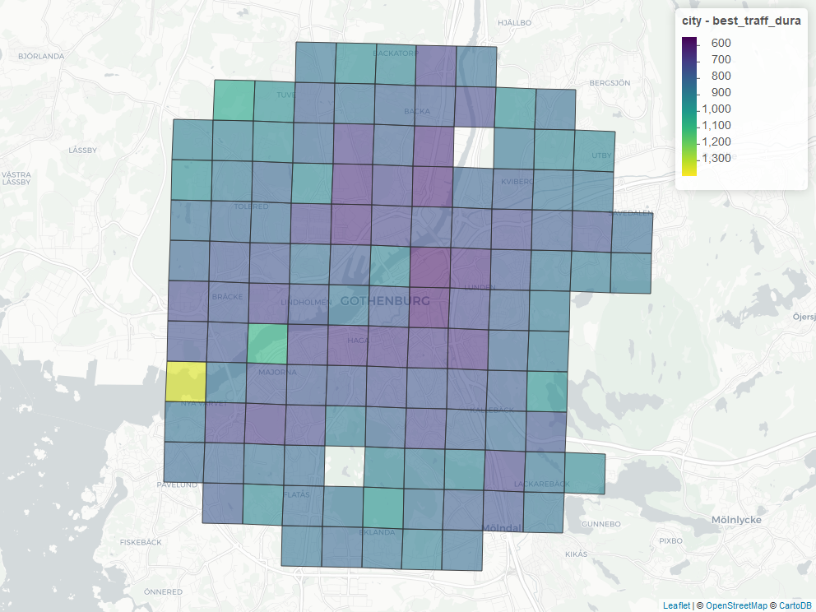
Goteborg

Slide 10
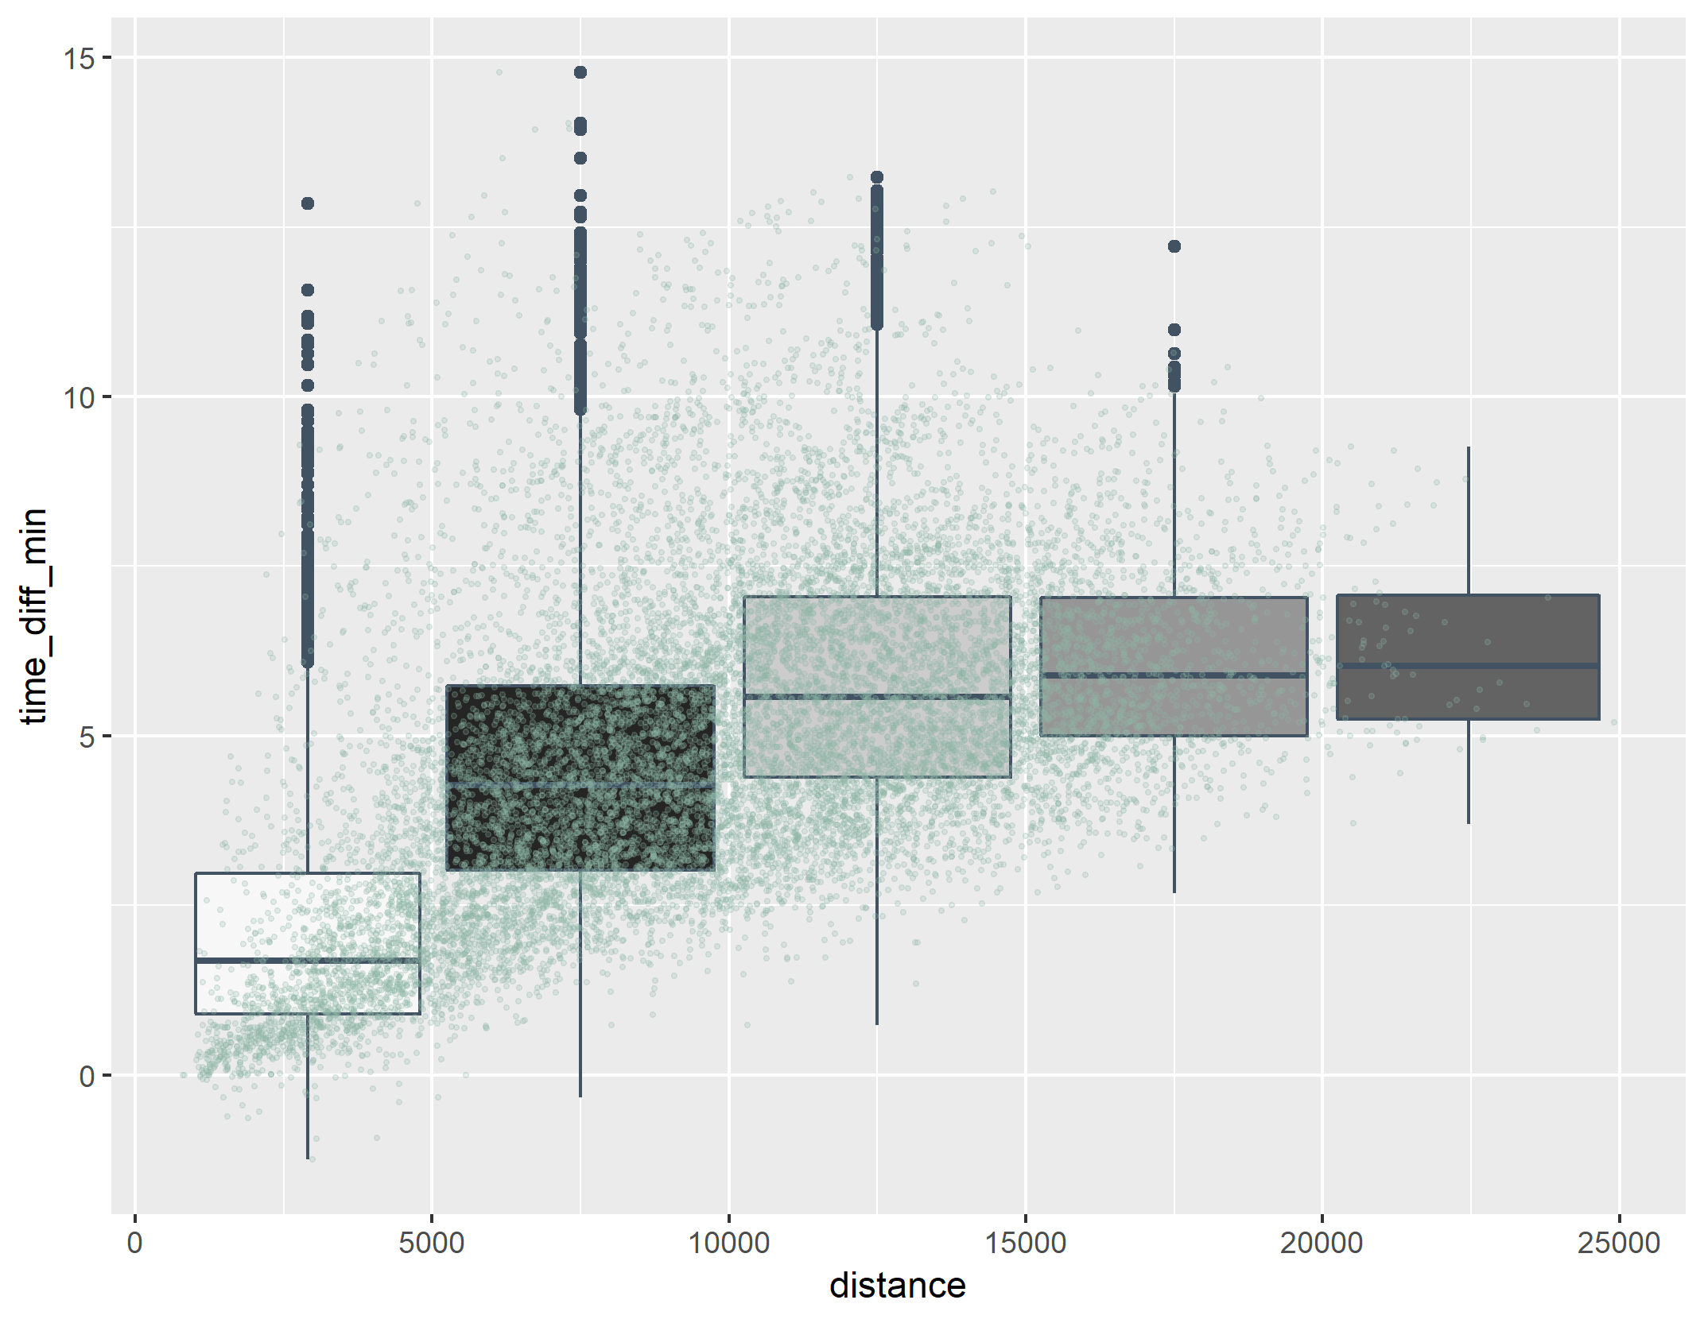
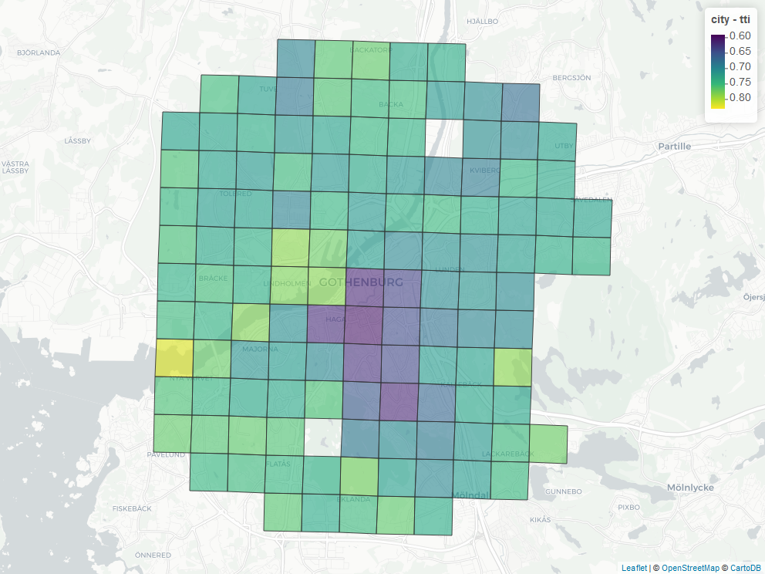
goteborg

Slide 11
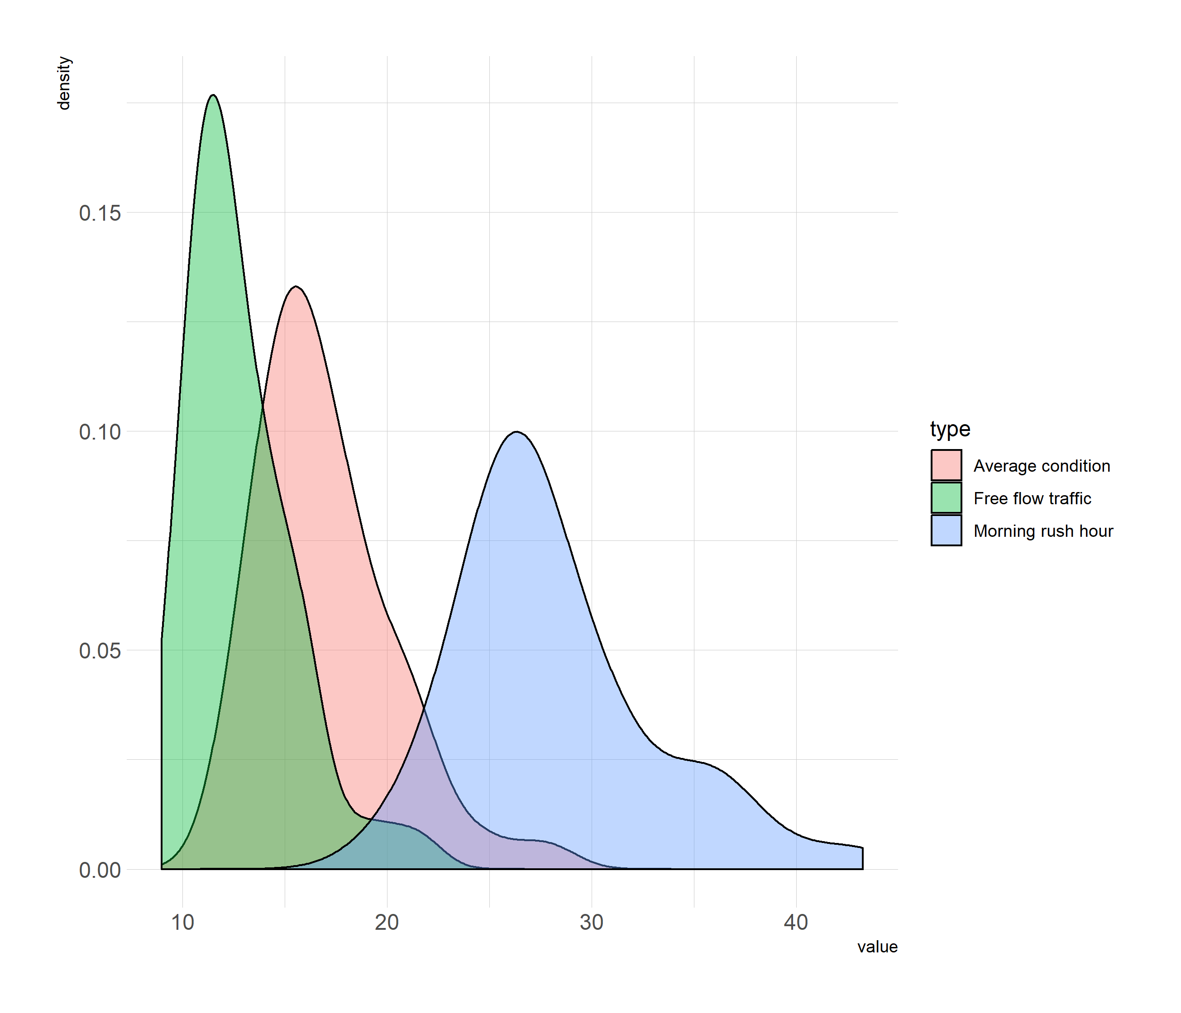
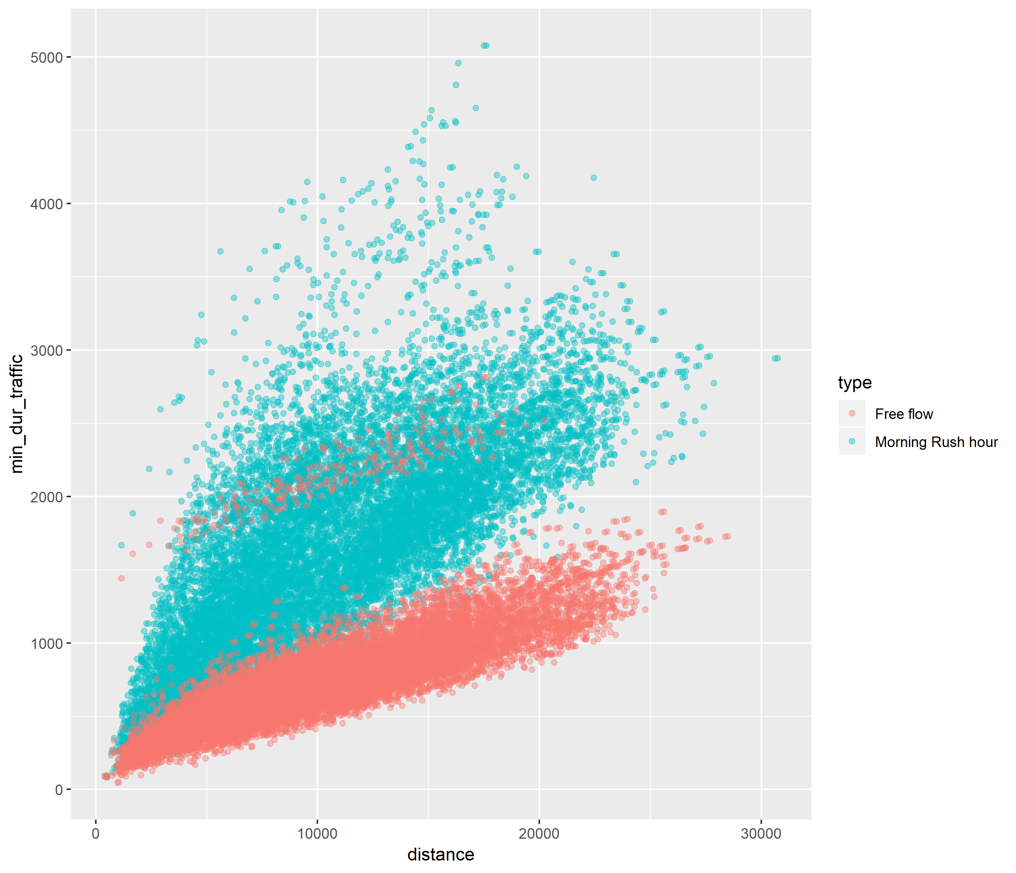
LISBON

Slide 12
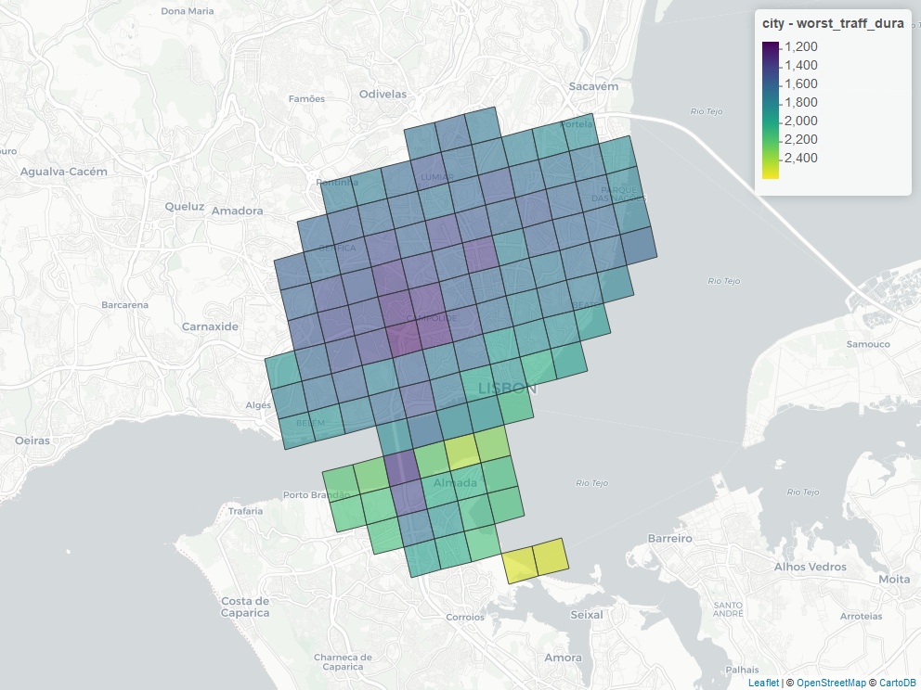
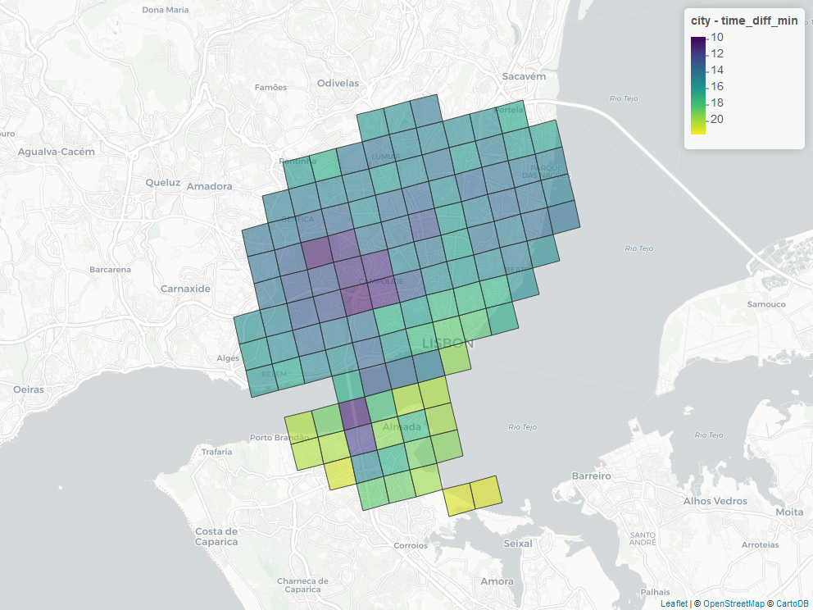
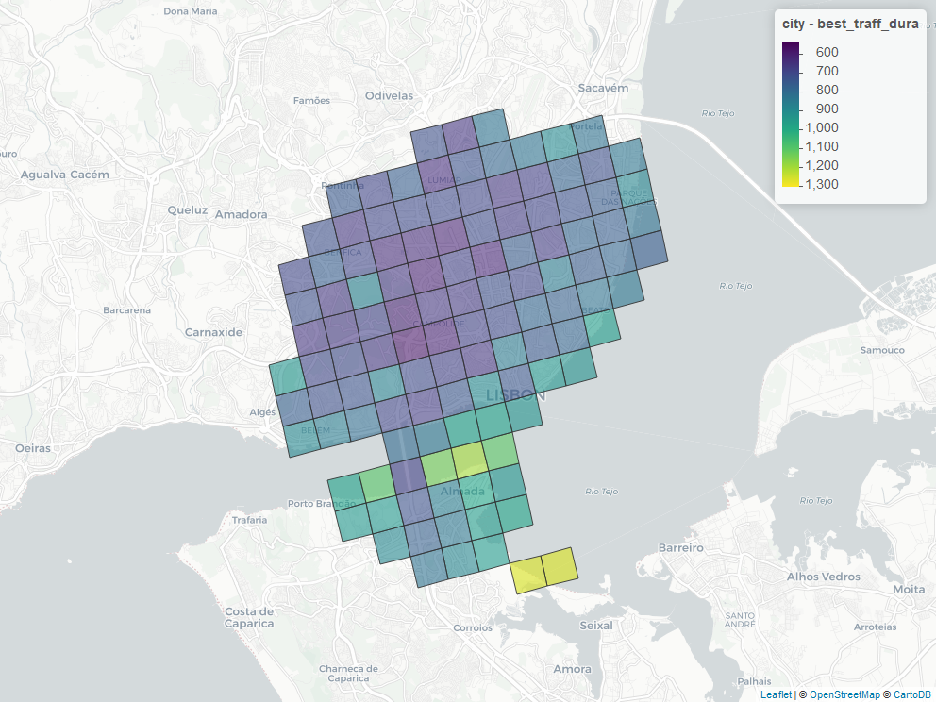
LISBON

Slide 13
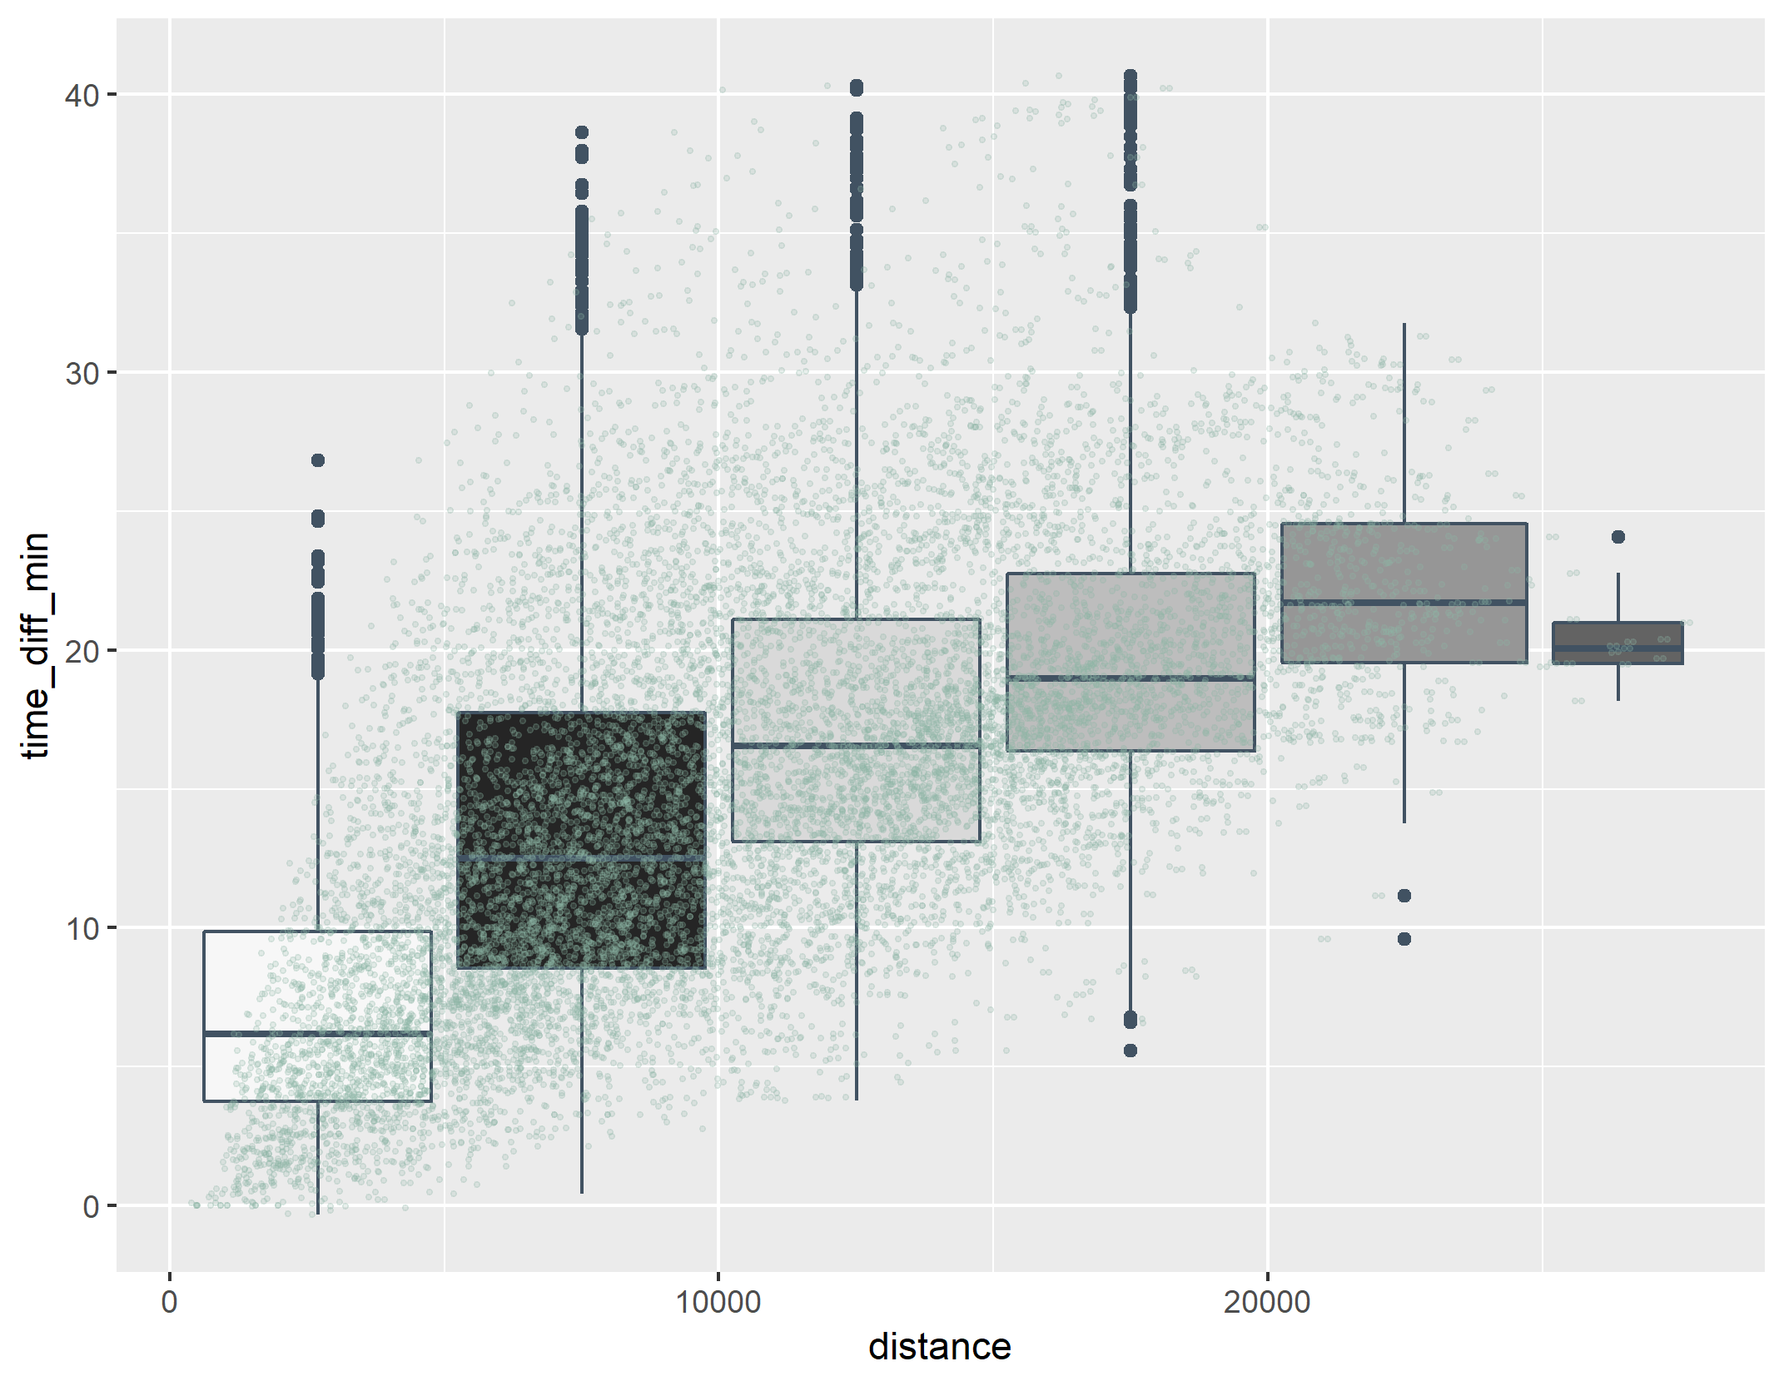
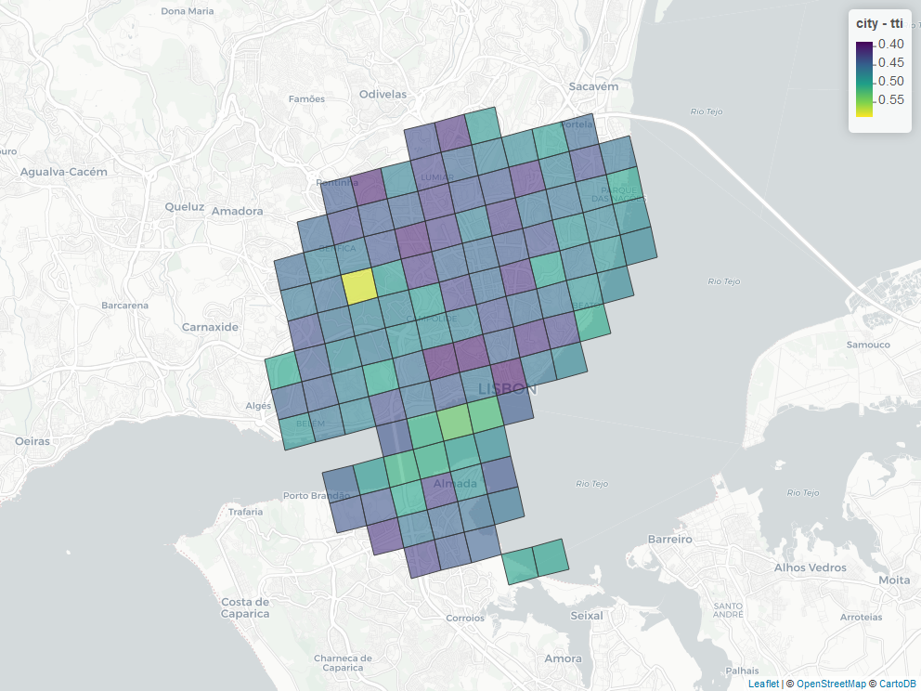
lisbon

Slide 14
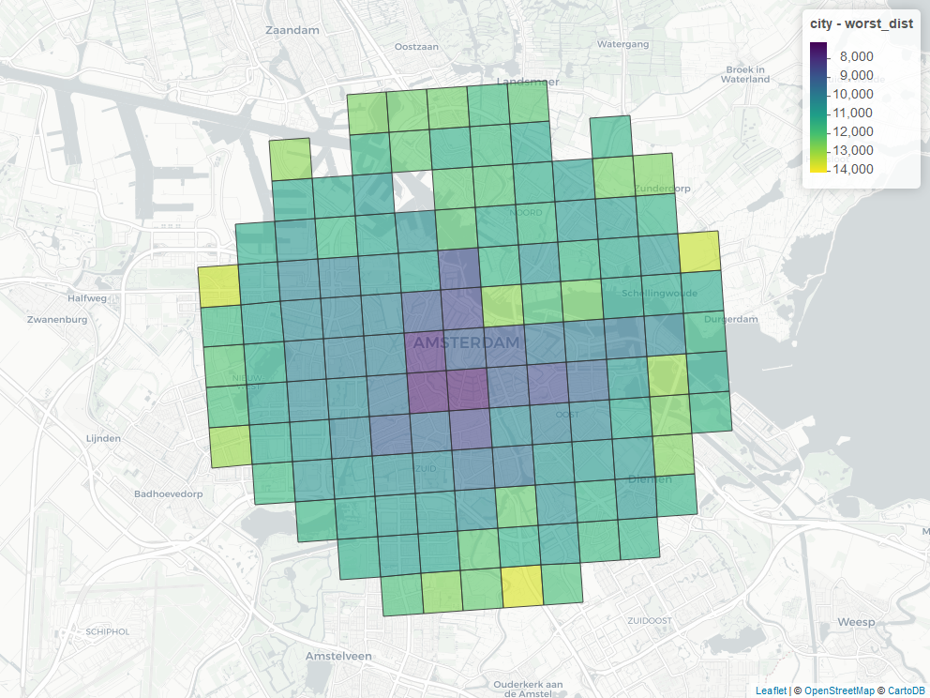
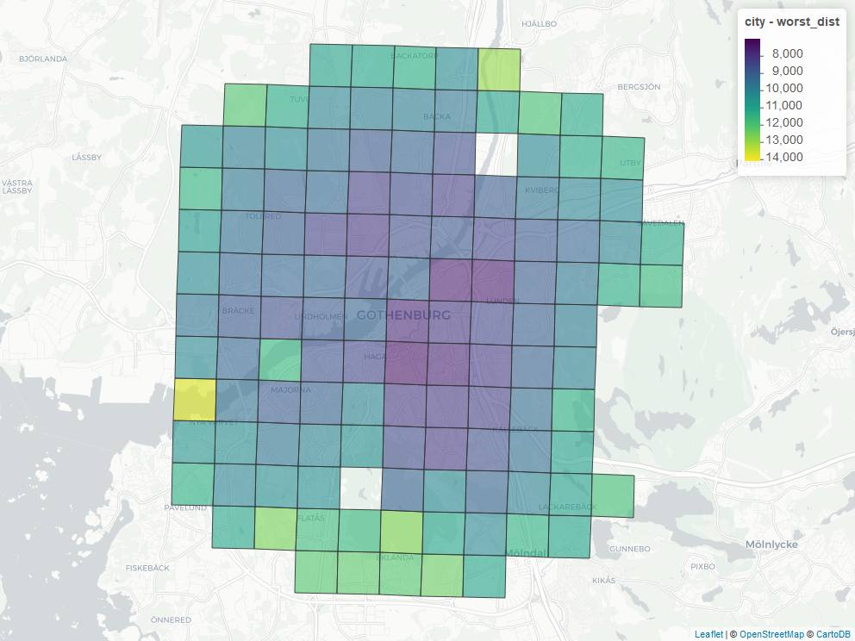
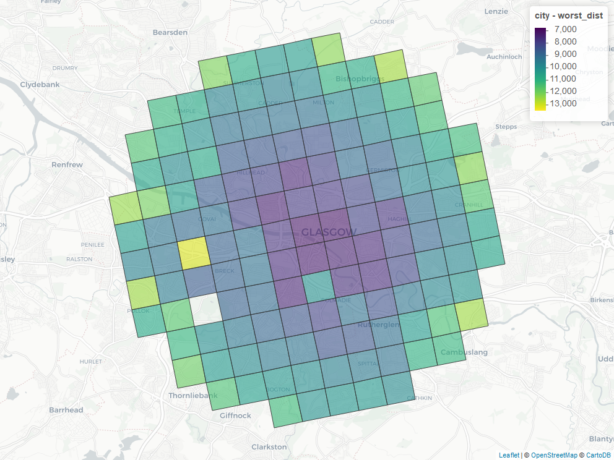
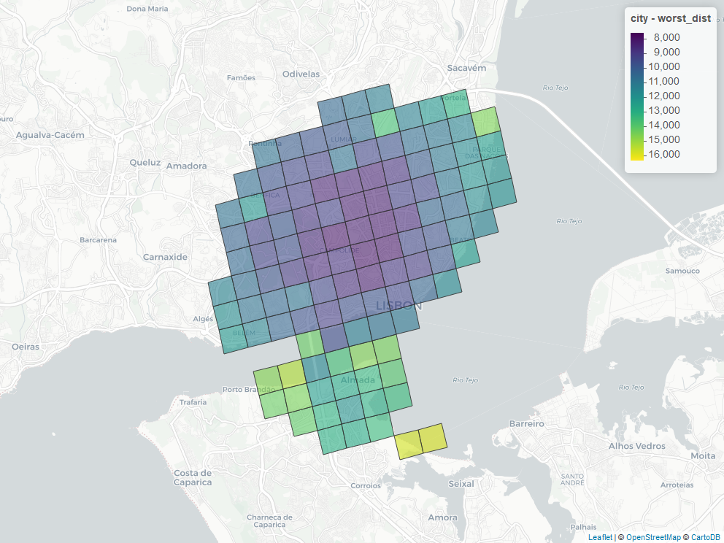
distance
GOTEBORG
AMSTERDAM
GLASGOW
LISBON

Slide 15
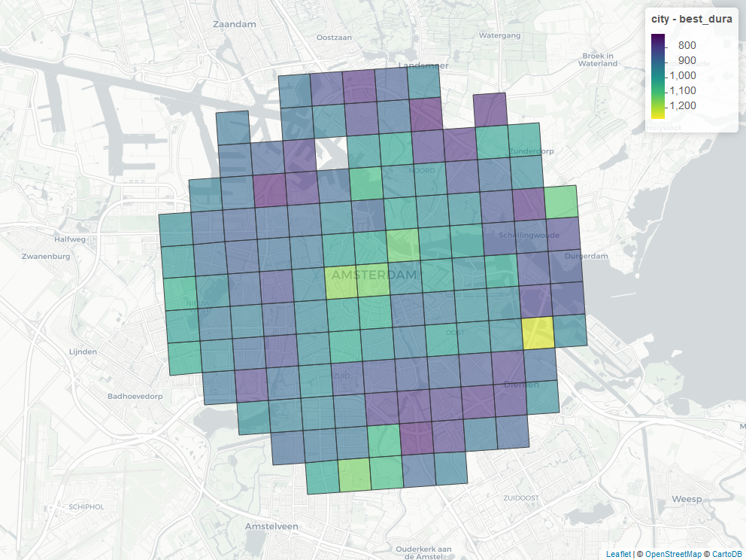
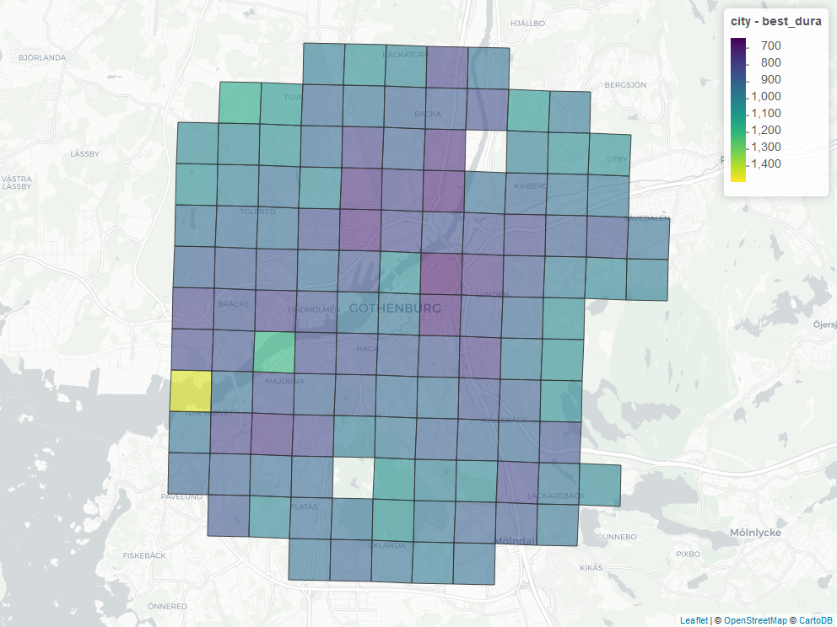
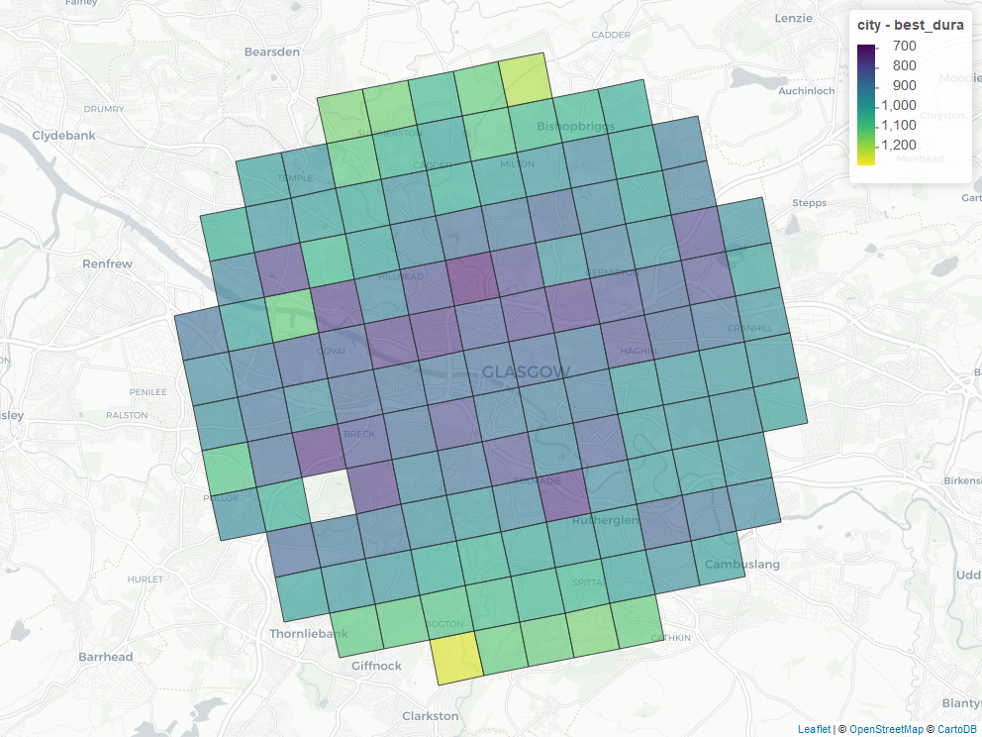
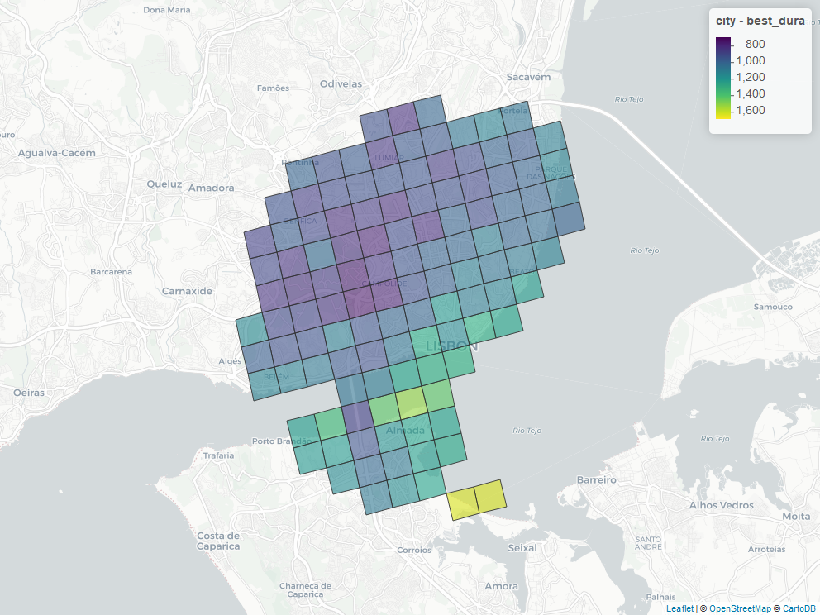
Average time
GOTEBORG
AMSTERDAM
GLASGOW
LISBON

Slide 16
Time Difference
GOTEBORG
AMSTERDAM
GLASGOW
LISBON

Slide 17
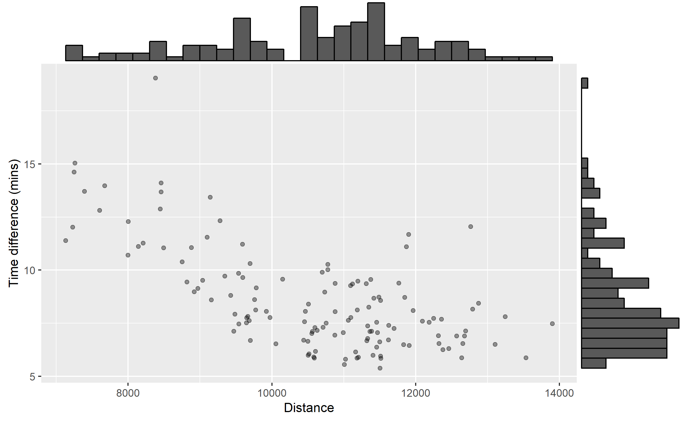
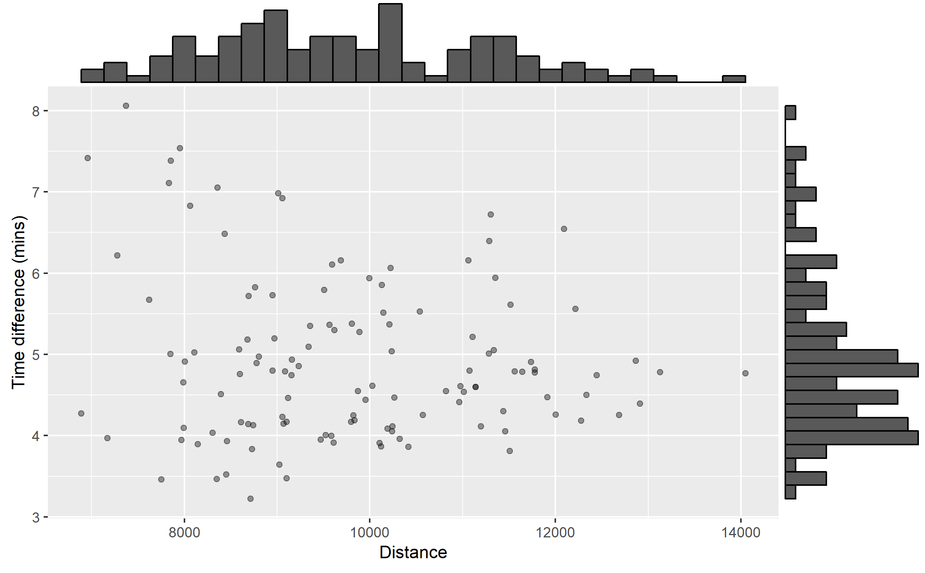
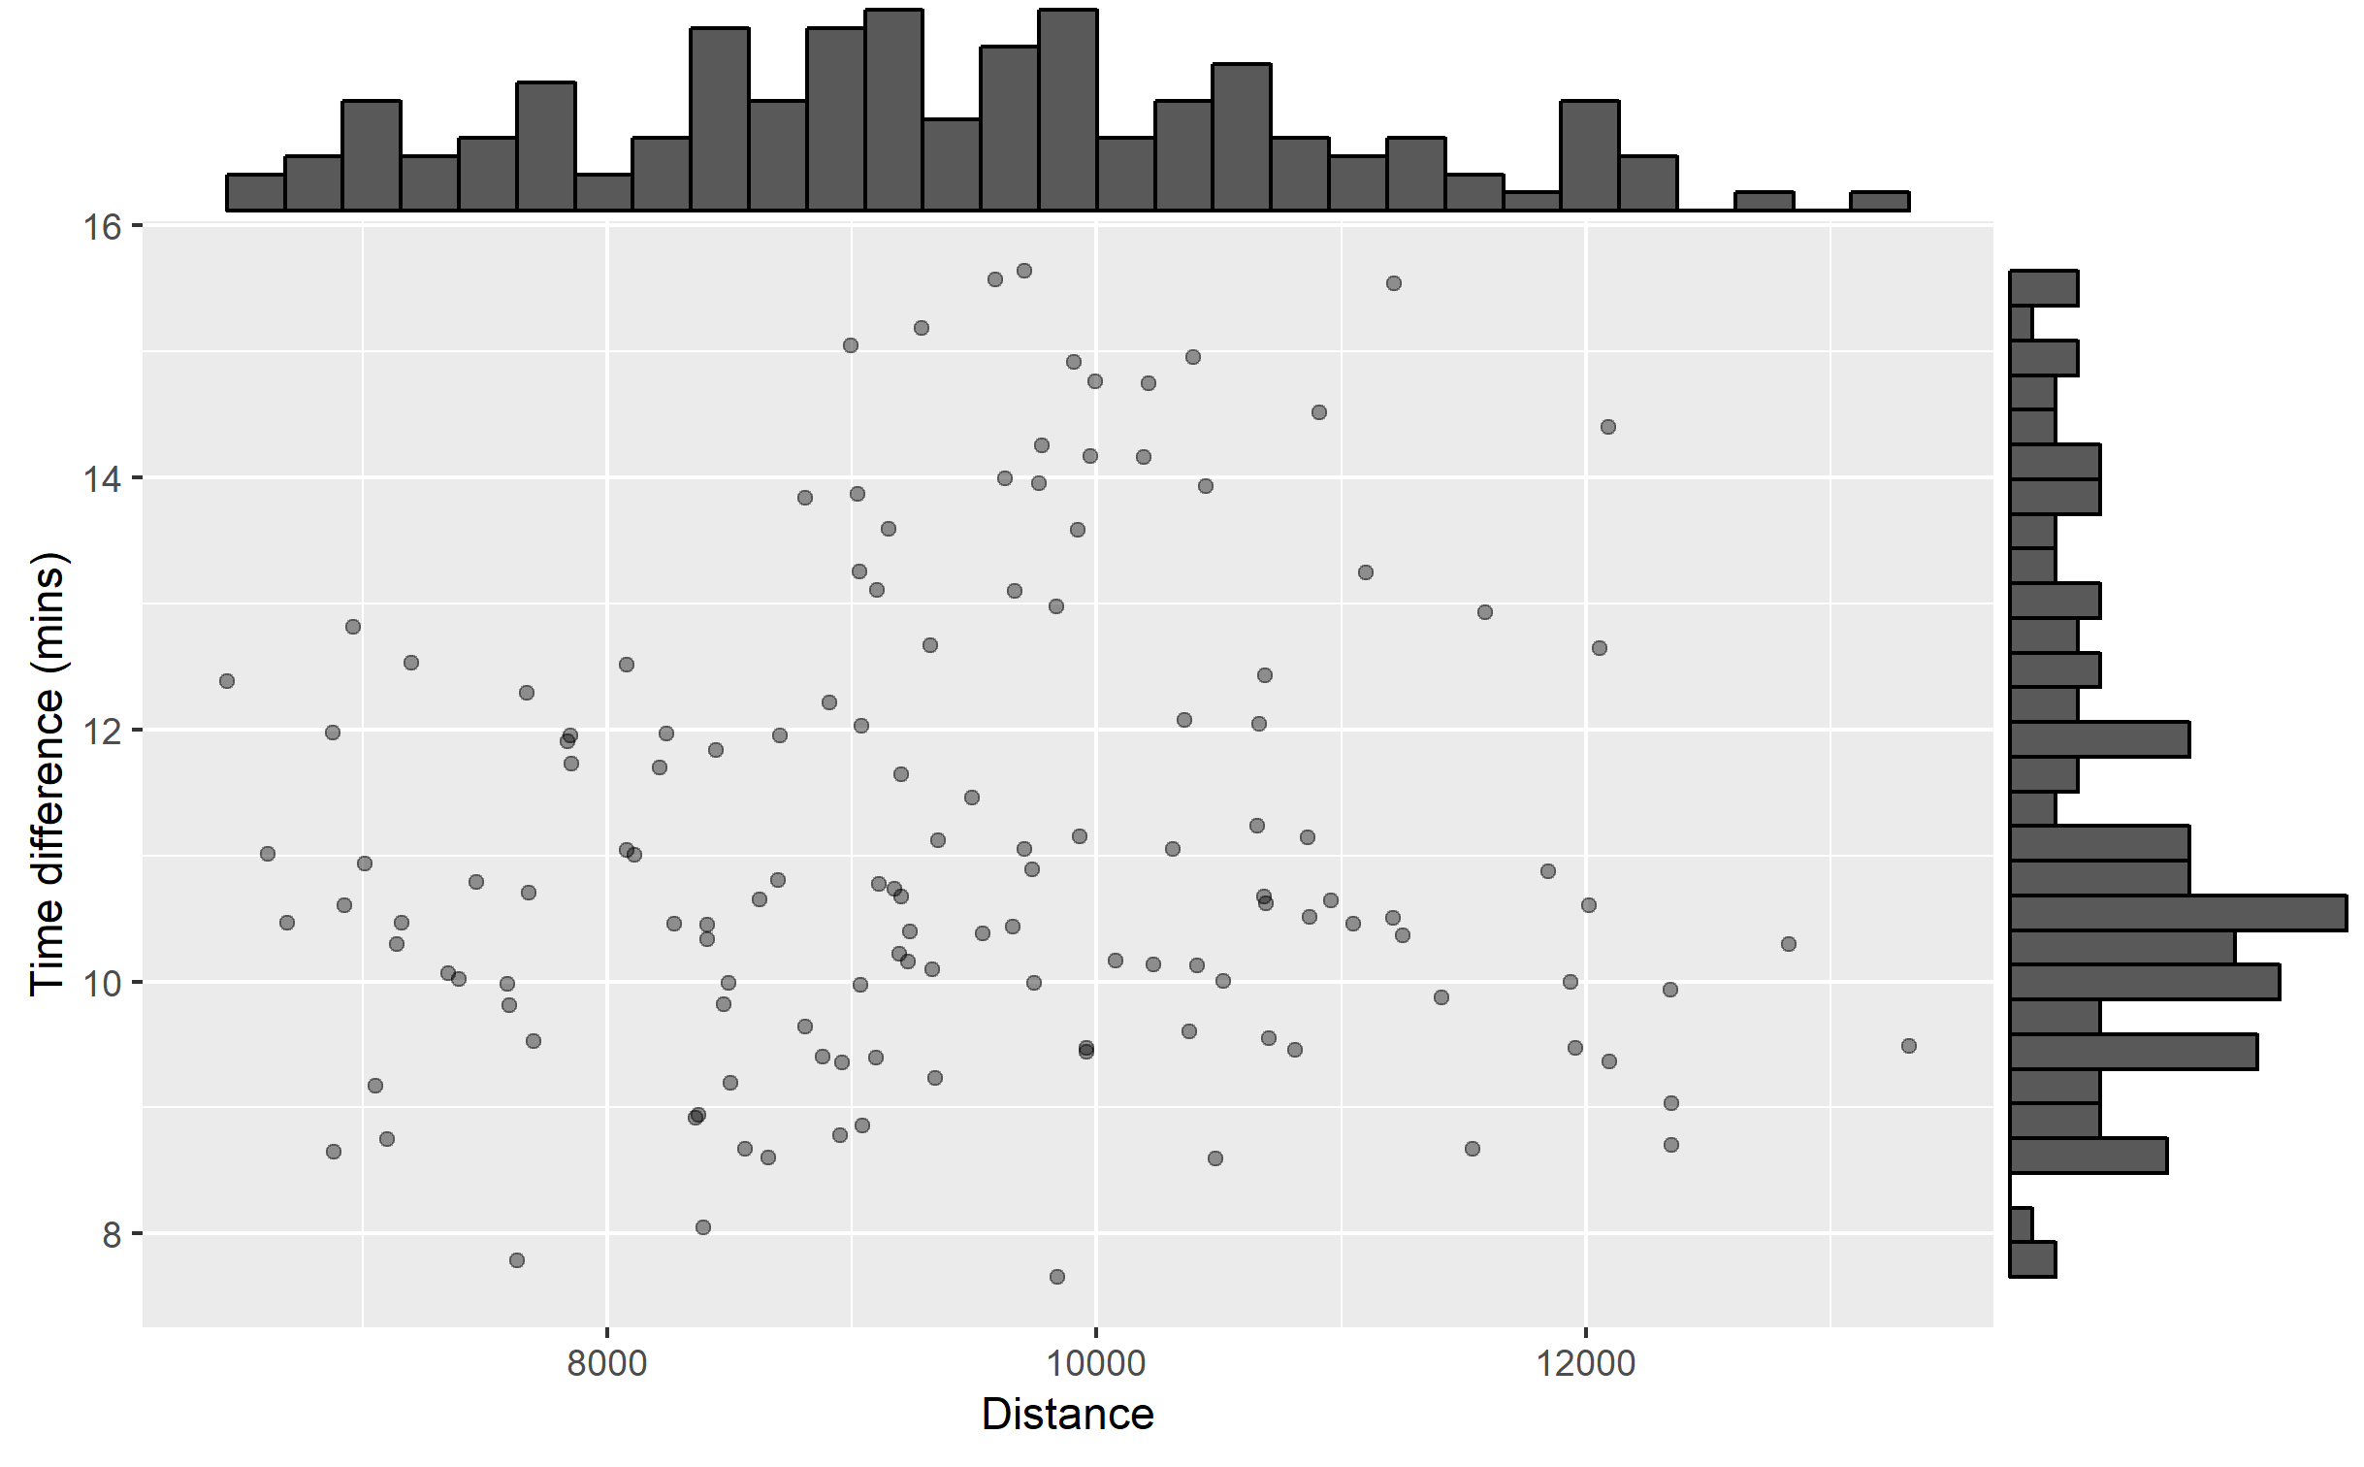
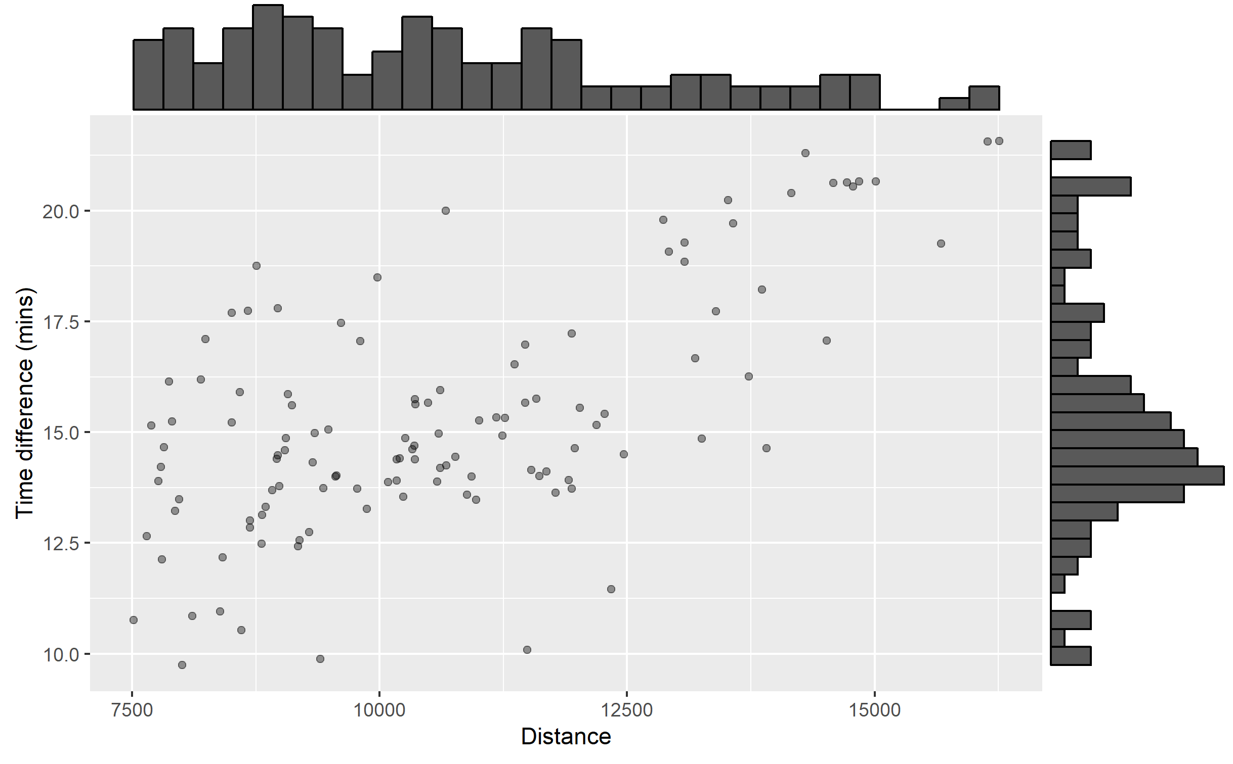
Time Difference rel
GOTEBORG
AMSTERDAM
GLASGOW
LISBON

Slide 18
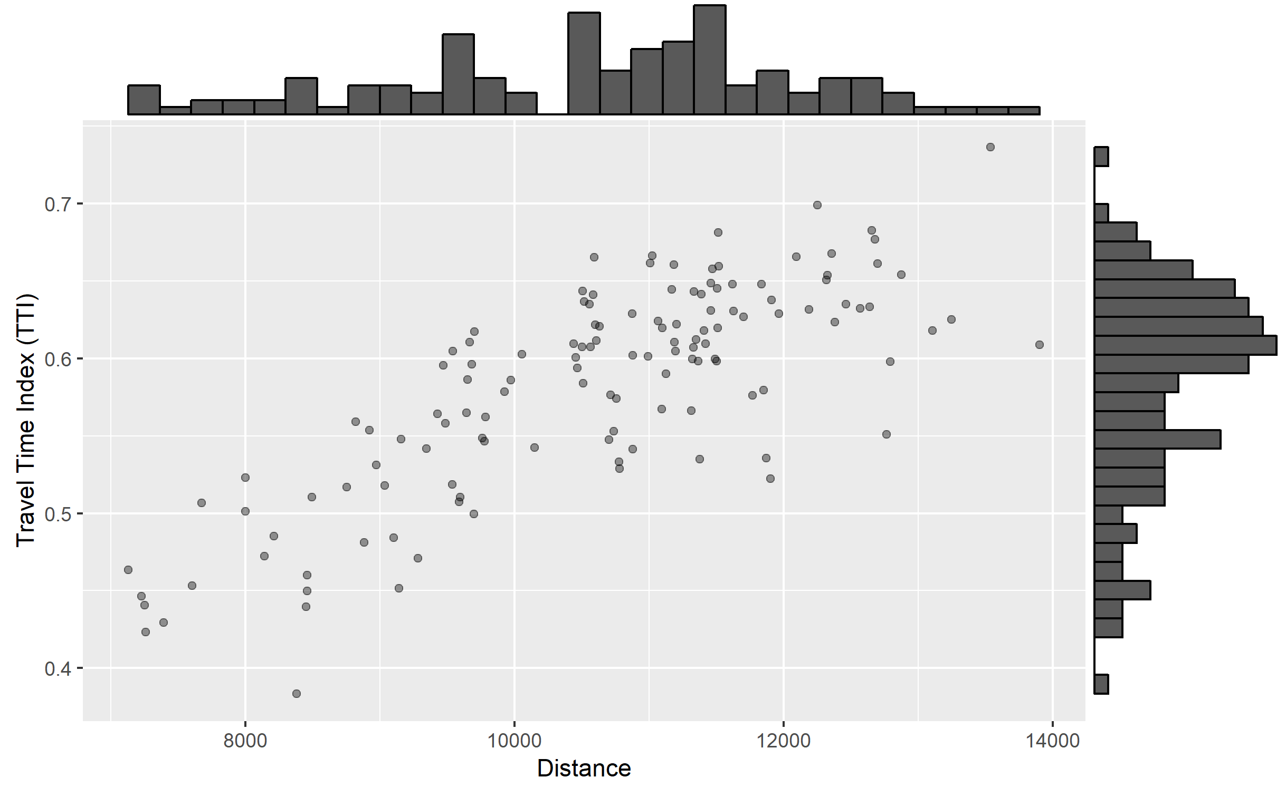
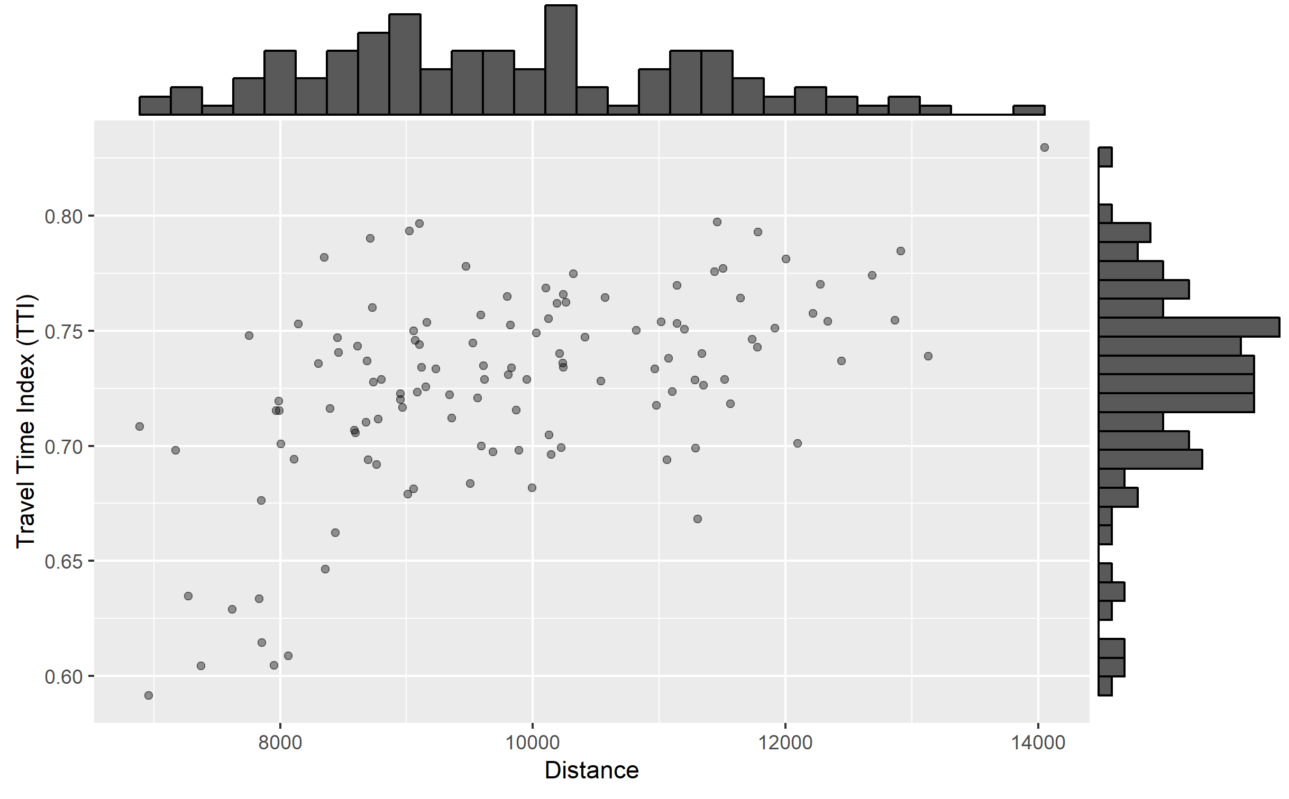
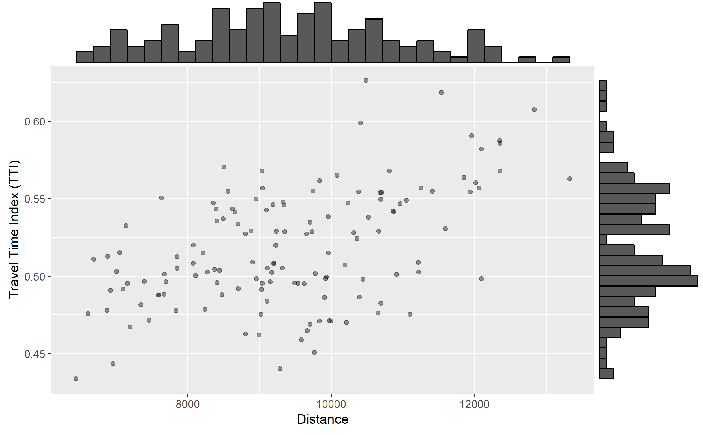
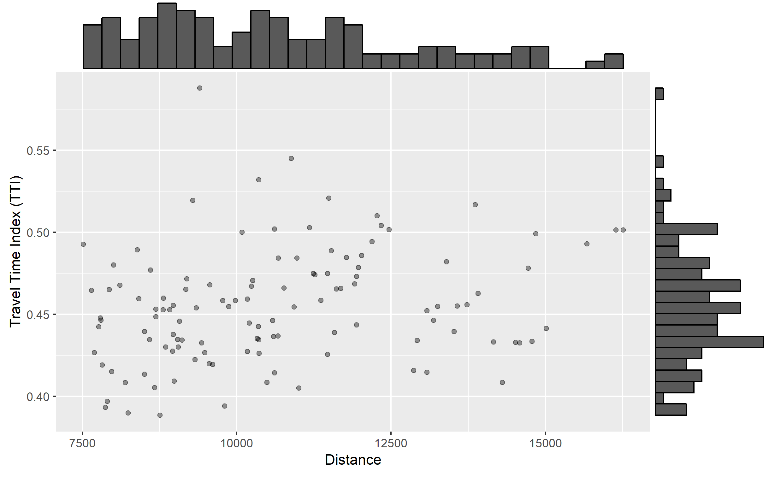
TTI
GOTEBORG
AMSTERDAM
GLASGOW
LISBON

Slide 19
Time vs distance
GOTEBORG
AMSTERDAM
GLASGOW
LISBON

Slide 20
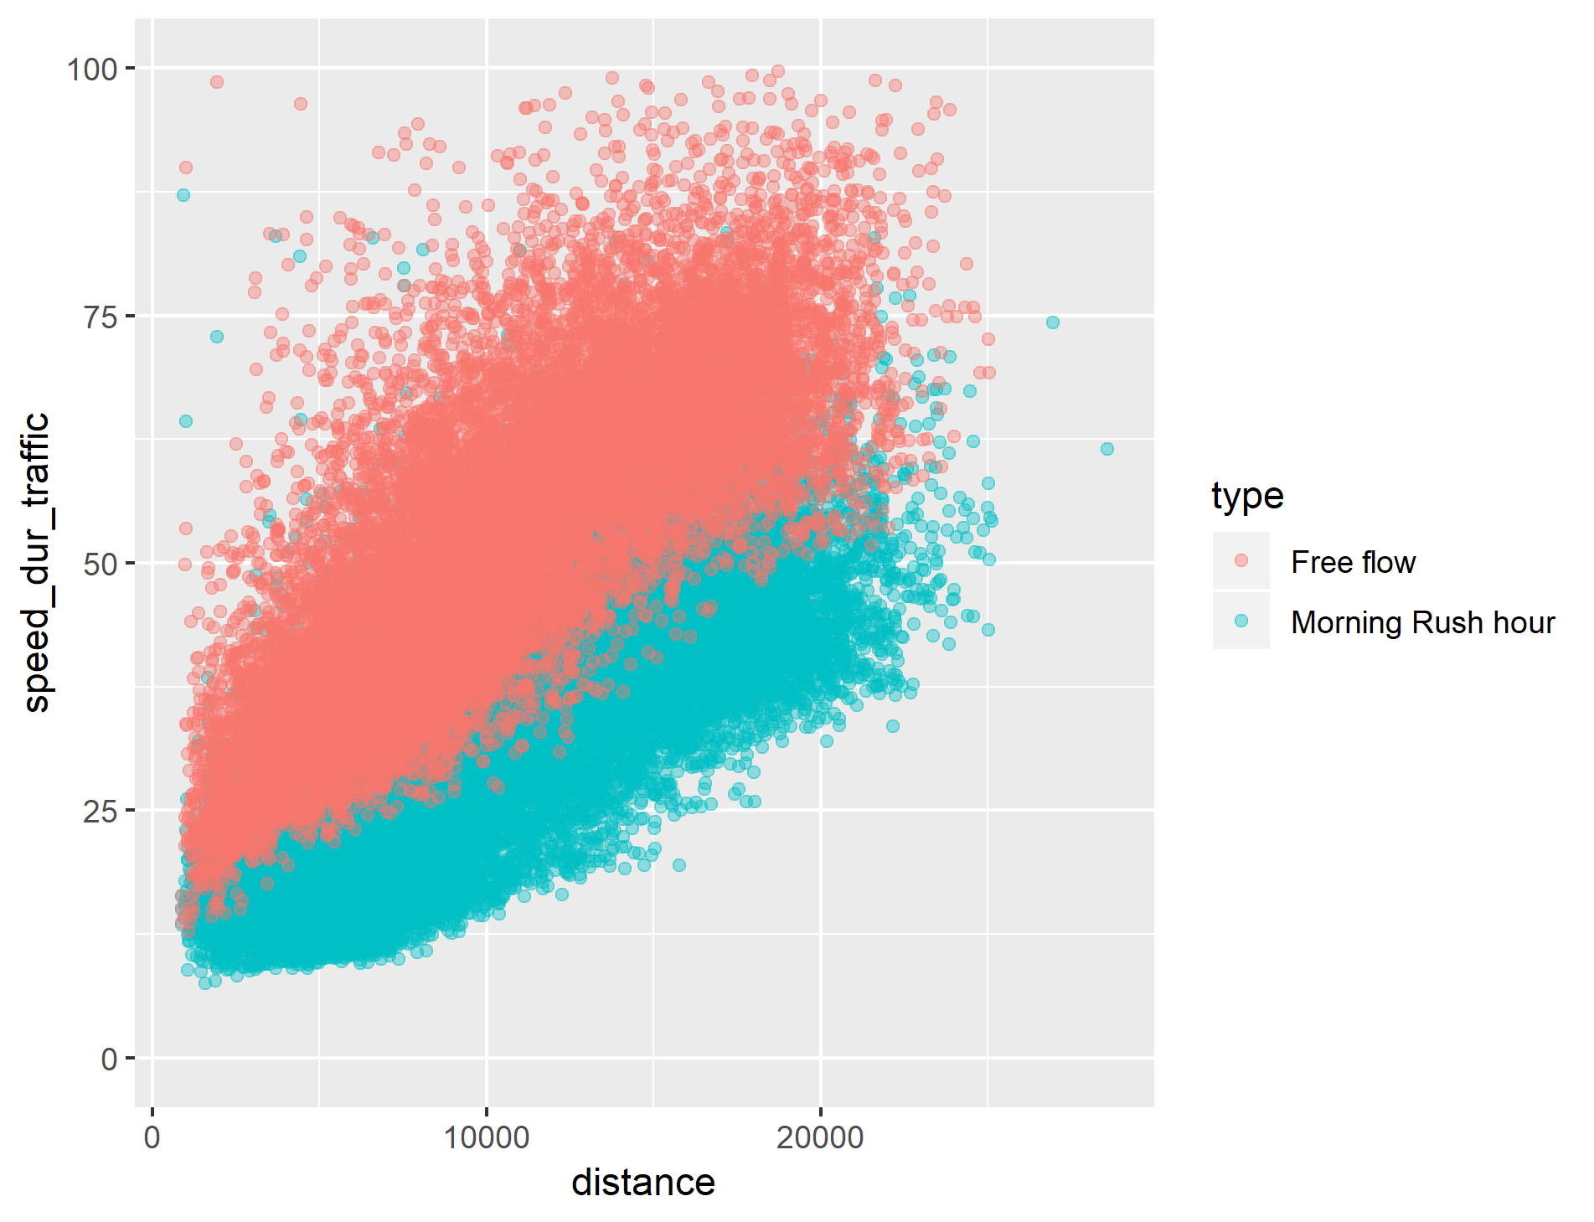
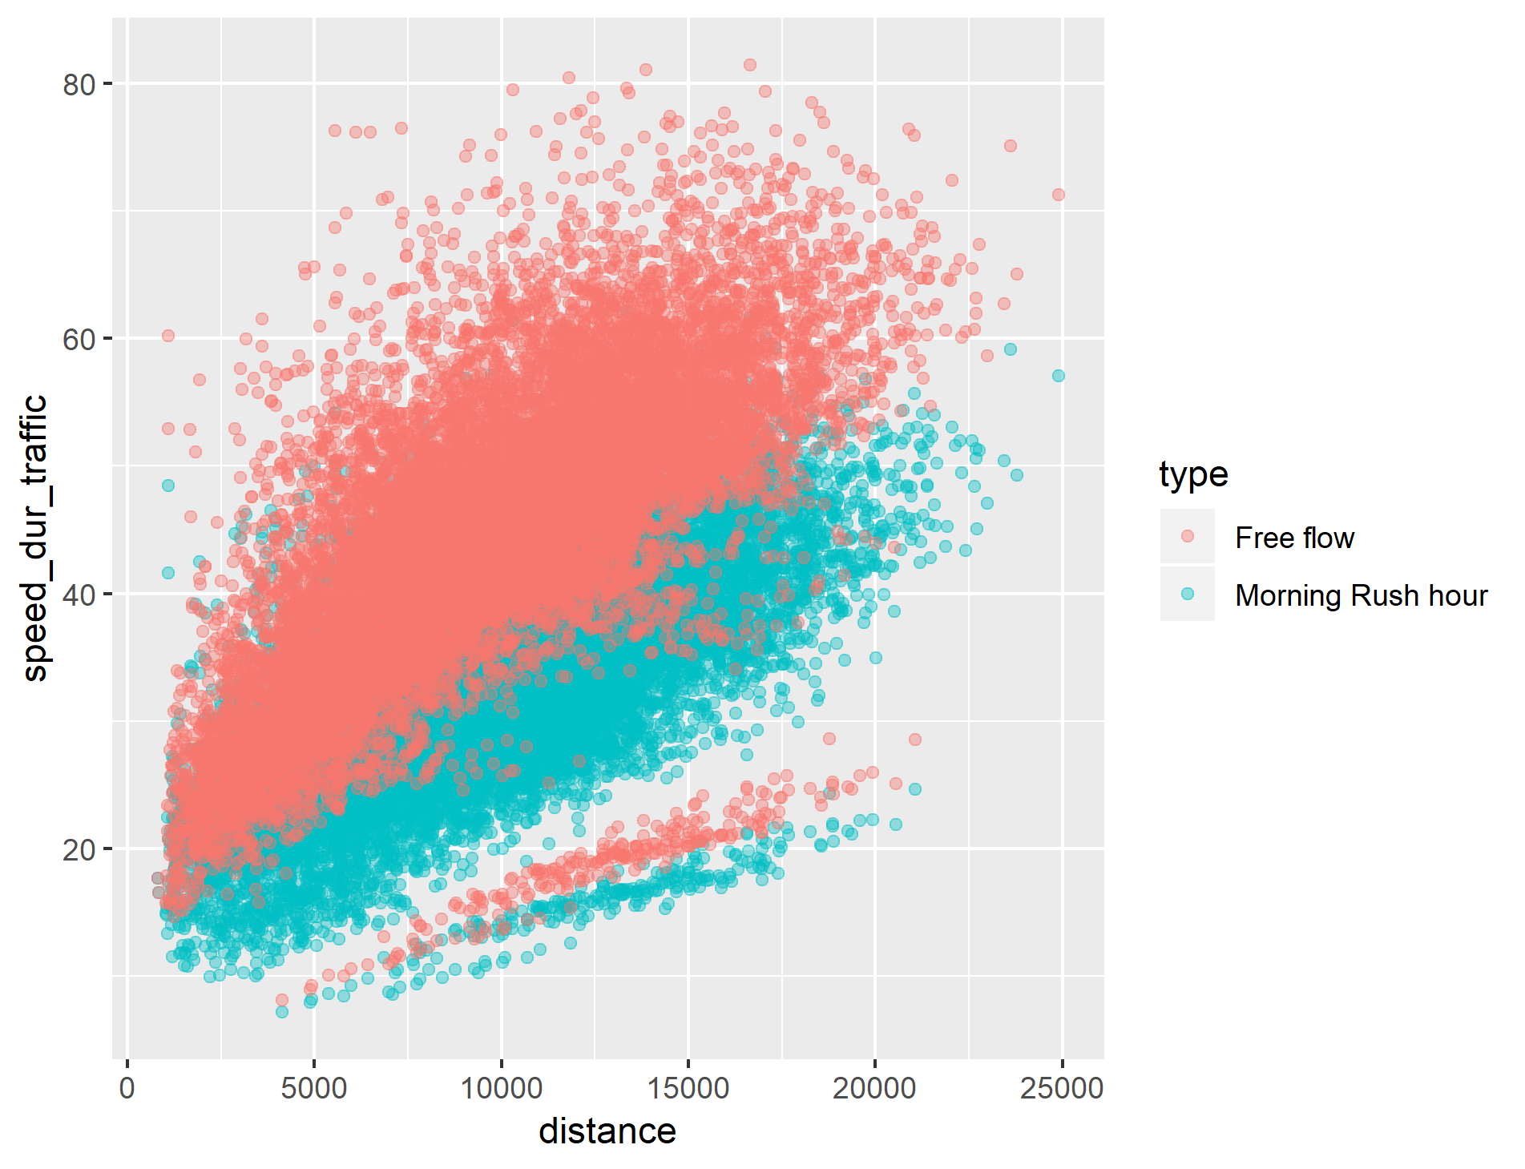
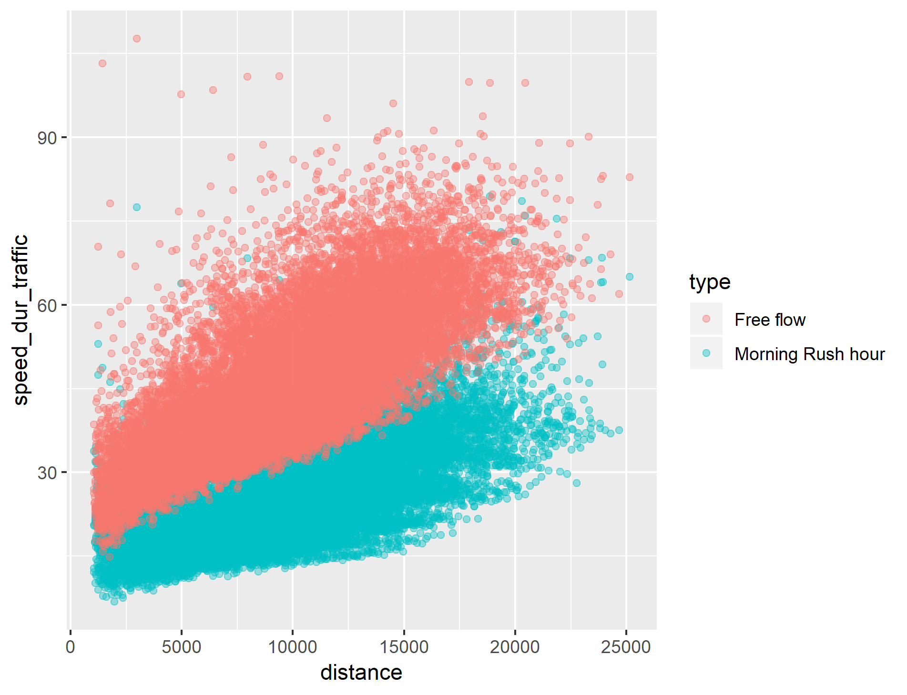
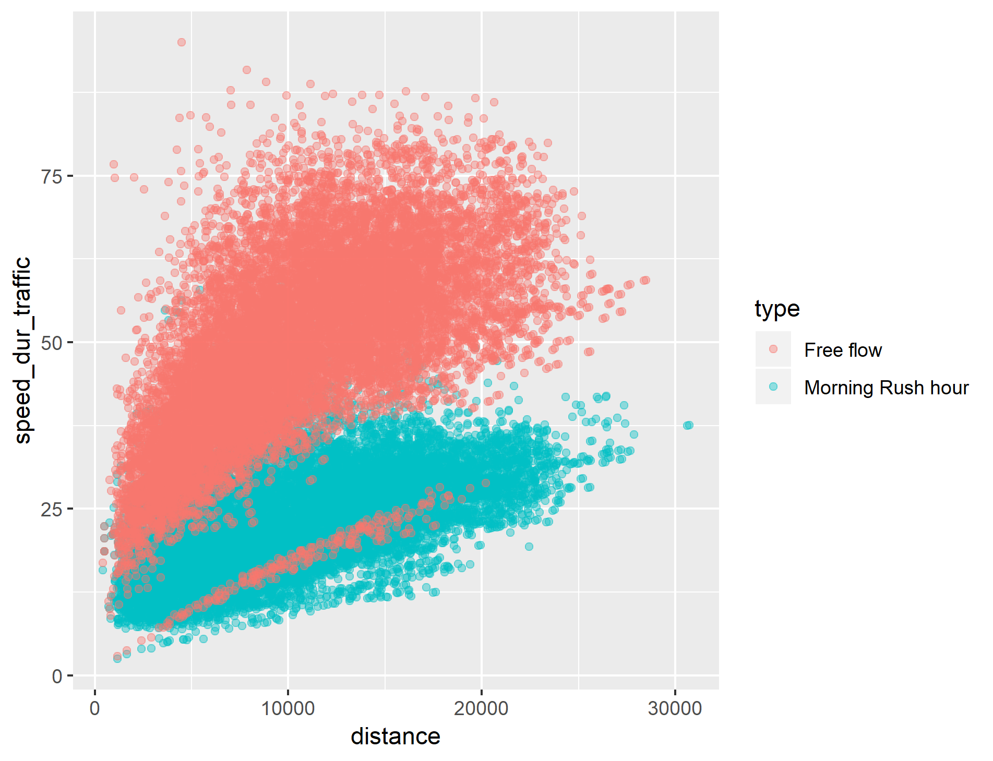
speed vs distance
GOTEBORG
AMSTERDAM
GLASGOW
LISBON

Slide 21
Time histograms
GOTEBORG
AMSTERDAM
GLASGOW
LISBON

Slide 22
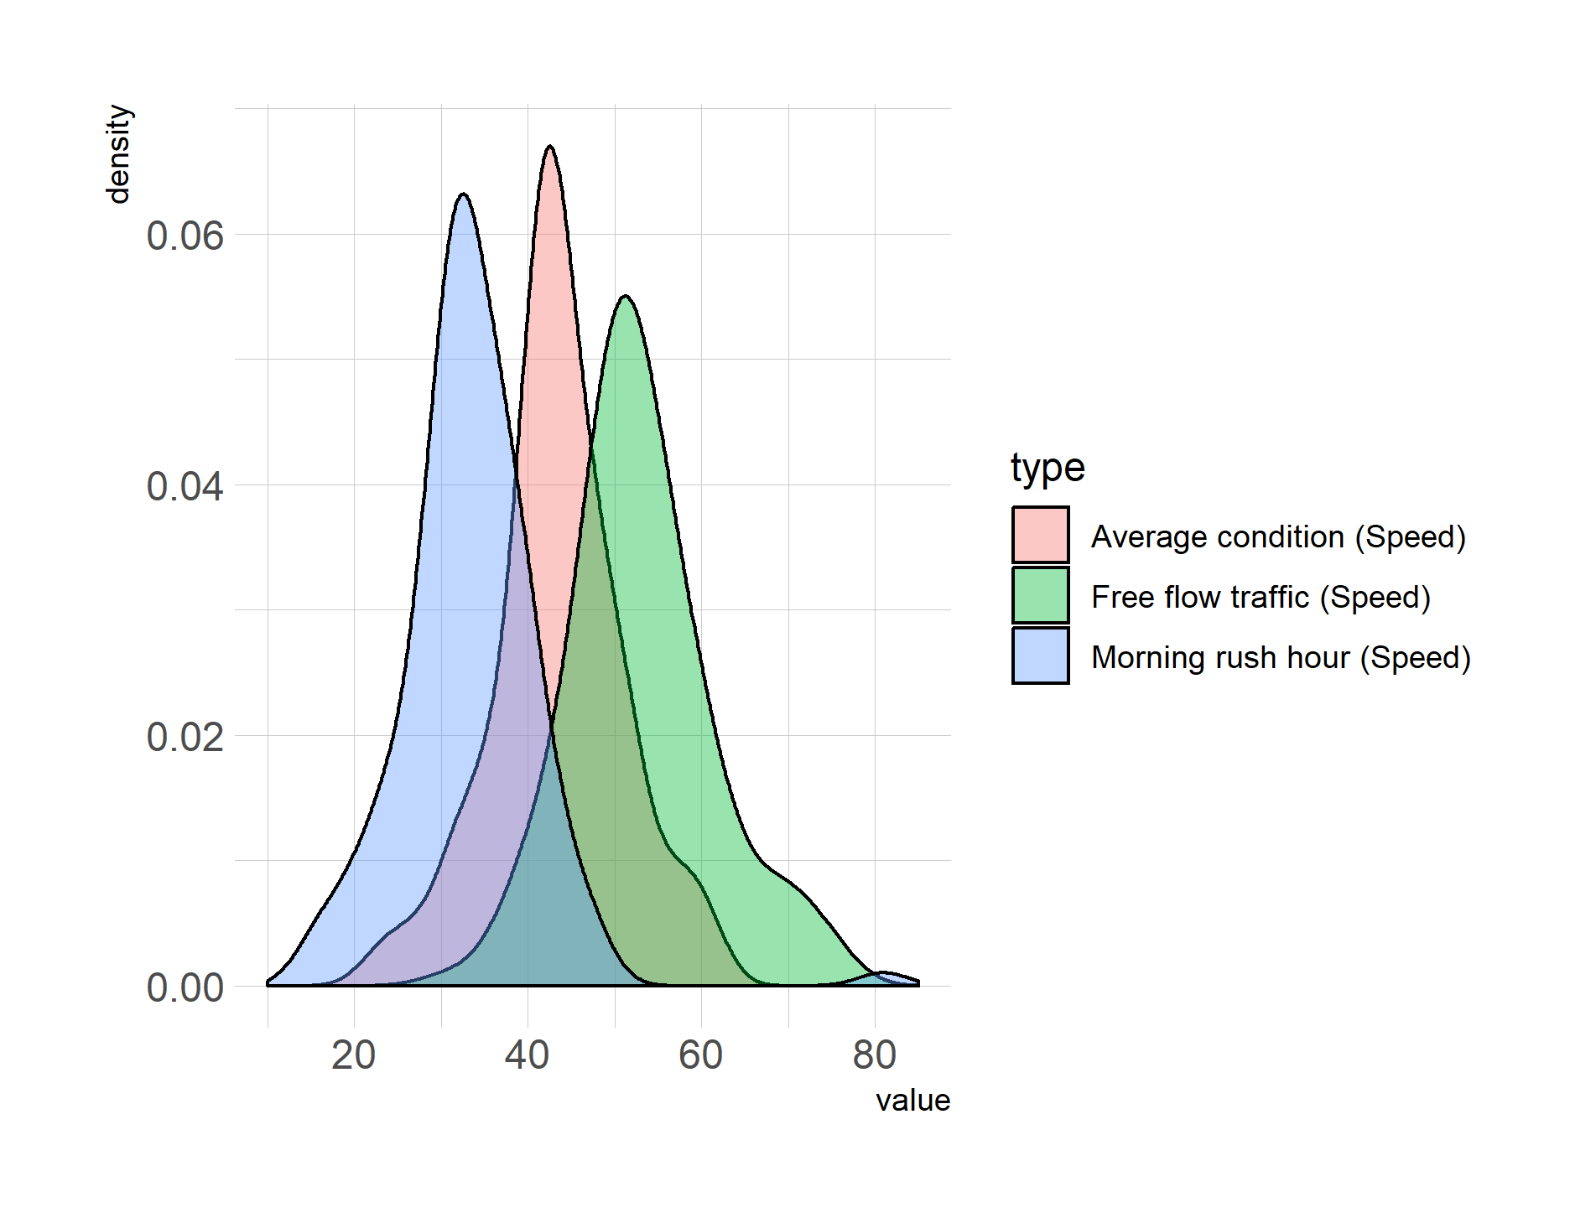
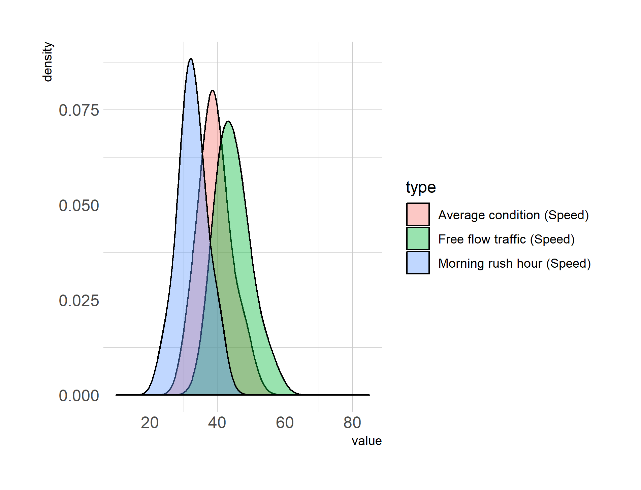


SPEED histograms
GOTEBORG
AMSTERDAM
GLASGOW
LISBON

Slide 23




GOTEBORG
AMSTERDAM
Time Difference
GLASGOW
LISBON

Slide 24
profiles
AMSTERDAM
GLASGOW
GOTEBORG
LISBON

Slide 25



Mean values

Slide 26



Mean values

Slide 27

overall

Slide 28

comparison

Slide 29

comparison

Slide 30


comparison

Slide 31


comparison

Slide 32


Time difference

Slide 33


Time difference (FLEX)

Slide 34


Time rel

Slide 35


Time rel (FLEX)

Slide 36


TTI

Slide 37


TTI (FLEX)

Slide 38


https://mobility.tamu.edu/umr/congestion-data/

Slide 39
INRIX CONGESTION INDEX
http://inrix.com/scorecard/

Slide 40




https://www.tomtom.com/en_gb/traffic-index/ranking

